Slide 1
A.1.2. Physiological Concepts
A simple presentation of (human) physiology

Slide 2
What are Physiological Concepts?
1. There are in physiology, a few concepts or ideas that are important to start with before going into further (physiological) details.
2. In these slides, we will discuss three of these concepts:
Homeostasis
Set point
Feed-back (positive or negative)

Slide 3
B. Homeostasis (1)
Homeostasis is the ability of the body to keep its internal environment stable (that is; equilibrated or constant).
Homeostasis = “homeo-” which means home or body and “-stasis” which means static or stable.
What do we mean with “internal environment”?
These are all the conditions inside the body such as temperature, pH (=acidity), pressure, volume etc.

Slide 4
B. Homeostasis (2)
5. So, homeostasis is the capacity of the body to keep its inside organs and tissues stable in temperature, pH, blood pressure, blood sugar, and many other variables
6. One of the most familiar homeostatic systems is that of the body temperature control. A normal body temperature is set at 37 ºC (= 98 ºF)
7. The temperature outside the human body however can vary from very cold to very hot! In all these different external temperatures, the temperature inside the body must remain constant at 37 ºC.
8. How does the body do that?

Slide 5
C. Homeostasis Temperature Control (1)
1. The point of this regulatory system is to keep the temperature inside the body constant at 37 ºC, irrespective of the outside temperature.
2. But, if the outside temperature is lower than 37ºC then the body will lose heat, through the skin, and through the respiration (breathing out the warm air). This would then lower the temperature inside the body.
3. To “push” the temperature inside the body back to 37 ºC, the body must generate heat.
4. The most common way to generate heat is with its metabolism (=biochemical reactions inside the cells of the body).
5. All biochemical reactions always generate some heat. This will increase the body temperature.

Slide 6
C. Homeostasis Temperature Control (2)
6. If the outside temperature is very low, then other mechanisms to generate heat are also put in action. A good example is shivering. This generates a lot of heat!
7. But what happens if the outside temperature gets too high, above 37ºC?
8. Then the opposite happens, the body must lose heat to get back to 37ºC. Again, there are several mechanisms to do that, such as sweating, evaporation, etc.
9. In summary, the homeostatic temperature control system works by either generating heat or by losing heat, as required.
10. But, how does the body know that it has to lose or has to generate heat? That is the function of a set point together with a feedback loop!

Slide 7
D. Set point and feed-back loop (1)
1. A set point is the value at which the body wants to keep something constant and stable, in this case the temperature.
2. Such a set point is often located in the brain, although nobody has yet been able to identify the exact location of this particular set point.
3.The homeostatic system, also called a ‘control system’, always uses this set point as a constant reference for its action.
4. So, if the body temperature threatens to be too low, then the body will generate more heat. The opposite will happen if the body gets too hot.
5. But how does the body know its internal body temperature is too low or too high? For this, the body needs temperature sensors.

Slide 8
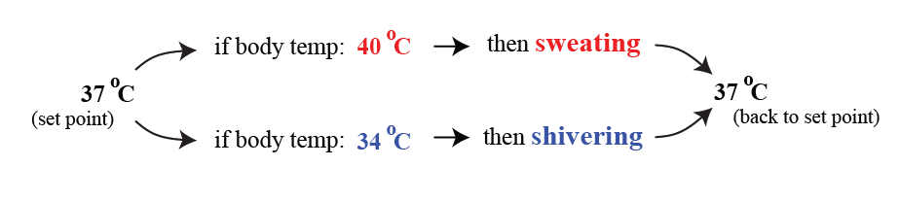
D. Set point and feed-back loop (2)
6. These body sensors measure the temperature in different parts of the body, inside the chest, the abdomen, the brain and in the skin.
7. These sensors constantly tell the brain set point whether the body temperature is ok, or too low, or too high.
8. If the temperature is too far off from the set point, then the brain decides to either increase metabolism, or to start sweating or shivering, or whatever is necessary to get the body temperature back to normal.

Slide 9
D. Set point and feed-back loop (3)
9. In other words, there is a loop from the sensors, through the set point to the action (shivering, metabolism etc.).
10. This loop is called ‘feedback’!!

Slide 10
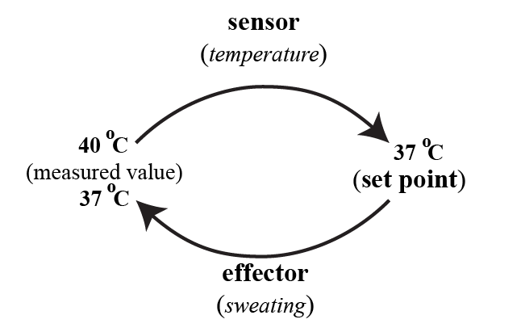
E. Negative and Positive Feedback Loops (1)
1. This is an important concept in physiology: a feedback loop.
2. A sensor measures, constantly, the body temperature, pressure, pH or whatever. These values are transmitted to specialized centers, often in the brain.
3. In that center, the measured value is compared to the set point of that variable such as the temperature.

Slide 11
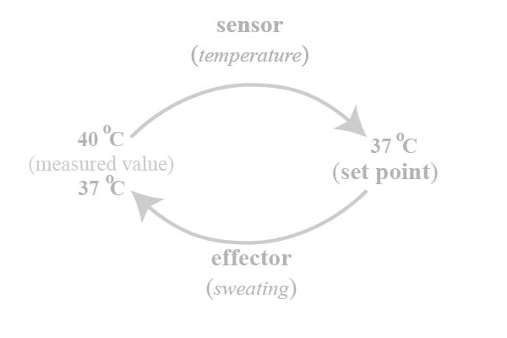
E. Negative and Positive Feedback Loops (2)
4. If the value is too high, then effectors are stimulated that will lower the value (temperature). If the value is too low, other effectors will be stimulated to raise the value
5. Please note that the system works in such a way as to reduce the fluctuations, in this case in temperature. In other words, the control systems work to restore the situation to the set point, i.e., the normal value.
6. This is called negative feedback. ‘Negative’ because it minimizes the fluctuations of the variables such as temperature in the body.

Slide 12
E. Negative and Positive Feedback Loops (3)
7. The opposite is also possible. This is the case in a positive feedback loop.
8. For example, hypothetically, if the temperature had increased, and if the system had stimulated the wrong effector, such as metabolism or shivering, then the temperature would further increase!
9. That obviously is not compatible with life. In fact, in biology, there are very few examples of positive feedbacks.
10. Most control loops in the body are negative feedbacks.

Slide 13
F. Other examples of negative and positive feedback loops (1)
1. The most famous example of negative feedback system is the heating in your house. The value of the thermostat in the living room is the set point. If the temperature in the room gets too cold, then the heater (= the effector) will be turned on and will heat the room until the set point is reached again.
2. Another example, outside of biology, is the cruise control of your car. When it is set at a chosen speed (= the set point), the car will automatically accelerate or decelerate if the speed gets too low or too high.
3. An example of a positive feedback is seen in blood clotting. When a blood vessel is damaged, platelets will stick to the injured vessel and release a chemical attracting even more platelets to the same site. This will attract more and more platelets and increase the clotting process (until the bleeding has stopped).

Slide 14
F. Other examples of negative and positive feedback loops (2)
4. Other examples of positive feedback can be found elsewhere; such as your money in a bank account with a nice interest. As the interest value raises the total amount, over time, more and more interest is accrued!
5. Some scientist think that the current global warming is an example of increasing CO₂ emissions that, in turn, further raises the earth temperature; a positive feedback loop!
6. By the way, there are situations in the body when the set point can be changed! This is for example the case when one runs a fever. Then the set point is raised, because the body needs extra metabolism to battle an infection, and this increase in set point will then ‘automatically’ increase the body temperature.

Slide 15
G. Interesting to know!
1. Oh yes; not all animals have a stable body temperature.
2. Those animals that have a stable temperature in their internal environment are called homeotherm or endotherm (= warm blooded).
3. This is the opposite of animals that cannot regulate their body temperature: poikilotherm (= cold-blooded), such as frogs.
These poikilotherm bodies cannot regulate their body temperature at all!
4. As usual, this is a first introduction into the concept of ‘homeostasis’ and its components. As always in Physiology, there is much more known about this concept. If you are interested, I would encourage you to read a recent review written by Billman about this concept (see Physiology Literature).

