Slide 1
A.2.1. Structure of the Cell
Very Brief!!

Slide 2
What is a cell? (1)
A cell is the basic component of a body. The human body contains about 13 billion cells!
There are many types of cells; skin cells, red and white blood cells, nerve cells, muscle cells, just to name a few types.
All cells contain several types of organelles (= small organs inside the cell).
Some cells have specific organelles such as contracting fibers in muscle cells or vesicles in gland cells etc.
But most cells have similar organelles, which we will now discuss.

Slide 3
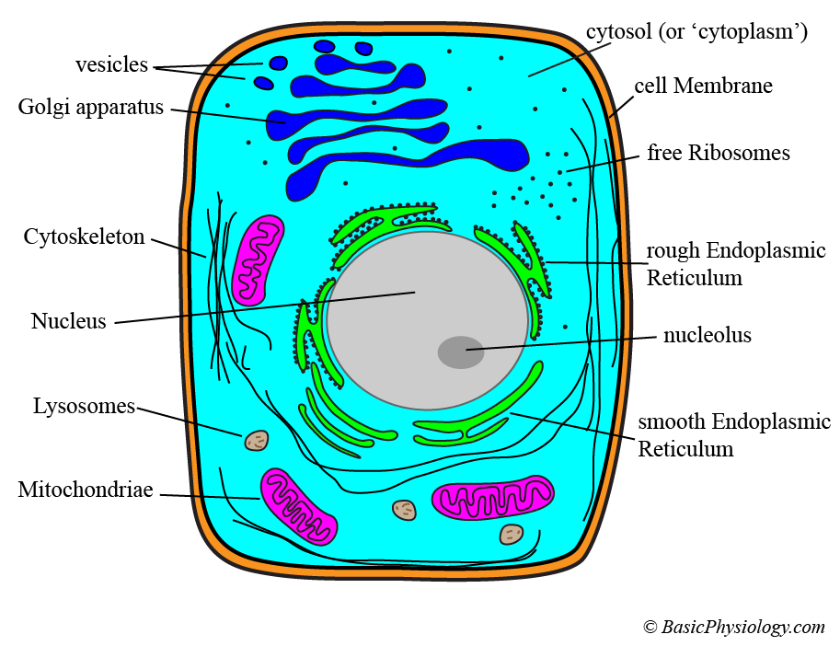
What is a cell? (2)
The major organelles in a cell are:
Nucleus
Cytoplasm
Cell Membrane
Endoplasmic Reticulum
Golgi apparatus
Lysosomes
Mitochondria
Cytoskeleton
Ribosomes

Slide 4
What is a cell? (3)
By the way, the interior of the cell is filled with a fluid that is called cytoplasm (cyto=cell and plasm=plasma or fluid).
So, what is the name of the fluid inside the nucleus? Right: nucleoplasm!

Slide 5
B. The Nucleus (1)
The nucleus contains the genetic material of the cell (and therefore of the whole body) in the form of DNA (=DeoxyriboNucleic Acid).
This, together with supporting proteins, is formed in strands called chromatin. Together, they form chromosomes (in humans 46, that is 23 pairs).
The nucleus contains a dense body called the nucleolus; this contains a lot of ribosomes and RNA (=RiboNucleic Acid).

Slide 6
B. The Nucleus (2)
The nucleus has many functions, but its main function is making messenger RNA from its DNA data bank.
Some cells don’t have a nucleus. A well-known example is the red blood cell (=erythrocyte). Because they don’t have a nucleus, they cannot repair themselves and are therefore doomed to die (in about 120 days).
Some cells have not one but several nuclei (plural of nucleus). The best-known examples are the muscle cells.

Slide 7
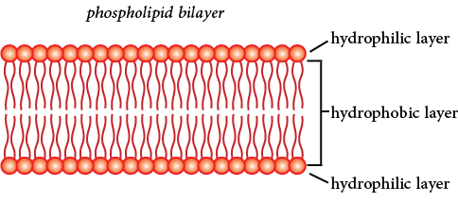
C. The Cell Membrane
The cell membrane consists of two layers of phospholipid molecules. These molecules are pretty ‘fluid’, like a gel. That is why this membrane is called ‘plasma’.
Inside this double layer, there are several other structures ‘floating’ around, such as protein channels, receptors, etc.

Slide 8
D. The Cytoplasm
The cytoplasm (=intracellular fluid; also called cytosol) consists of the fluid (=water) and all the soluble elements inside the cell, such as ions, proteins and metabolites.
In the cytoplasm, the organelles are also located, sometimes ‘floating’ around, sometimes fixed to the nucleus, to the cytoskeleton or to the plasma membrane.
The composition of the cytoplasm is very different from the fluid outside the cell: the extracellular fluid (extra = ‘outside’ the cell).
For example, there are many more K⁺ ions inside than outside the cell (140 mM vs. 5 mM) whereas the opposite is true for Na⁺ ions; much more outside than inside (10 vs. 145 mM).

Slide 9
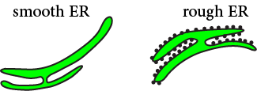
E. The Endoplasmic Reticulum (=ER) (1)
This ‘reticulum’ is a network of channels and sacs. They play a major role in collecting and transporting products through the cell.
There are two types of endoplasmic reticulum: the ‘rough’ and the ‘smooth’ ER.
The rough ER is studded with small ribosomes, all located on the cytosolic surface of the reticular membrane whereas the smooth ER does not have ribosomes.

Slide 10
E. The Endoplasmic Reticulum (=ER) (2)
The rough ER is linked and connected to the nuclear membranes. Its ribosomes are involved in the synthesis of proteins.
The smooth ER is involved in the synthesis of lipids, hormones and carbohydrates.
In muscle cells, the smooth ER are involved in the regulation of Ca²⁺ ions, which is important for generating muscle contractions. There, they are called ‘Sarcoplasmic Reticulum’. More about this in ‘Muscle Cell’.

Slide 11
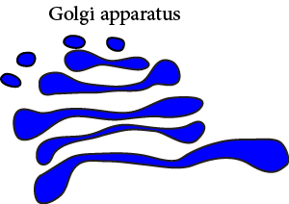
F. The Golgi apparatus (1)
This is also a kind of a reticulum, a collection of sacks and tubules. It was first discovered by the Italian Camillo Golgi; hence its name.
The Golgi apparatus (also called Golgi complex) gathers simple molecules, mainly from the ER, and combines them into larger and more complex molecules.
Finally, it also packages these new molecules into vesicles (small sacks).

Slide 12

F. The Golgi apparatus (2)
These vesicles are then sent to their destination, usually the plasma membrane where the content of the vesicles is dumped to the outside world: the extracellular fluid.
This process is called exocytosis (exo = 'exit' out of the cell).

Slide 13

G. The Lysosomes
Lysosomes are small sacks or vesicles (produced by the rough ER and released inside the cell by the Golgi complex). They contain enzymes that break down complex molecules such as proteins, carbohydrates and lipids.
Essentially, they destroy cellular organelles and large cellular molecules! They are literally the garbage collectors of the cell, which gets rid of cellular waste. It breaks down molecules into smaller and simpler molecules that can be used again; recycling!
Sometimes, they can also destroy their own cells. The lysosomes then behave as ‘suicide’ sacs!

Slide 14
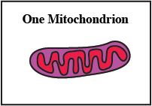
H. The Mitochondrion
The mitochondrion is the energy center of the cell. It produces ATP required for activating all biochemical processes in the cell.
It consists of a double plasma membrane: an outer and an inner membrane. The inner membrane is folded several times thereby forming ‘cristae’.
The mitochondria (plural of ‘mitochondrion’) also have other functions, such as calcium homeostasis in certain cells. Other functions are regulation of the cell cycle, cell growth, and sometimes even cell death!
Interestingly, these mitochondria also contain DNA molecules. This DNA comes from one parent, the mother (and not, as in the nucleus, from both parents). It forms therefore another genome than the DNA located in the nucleus.

Slide 15
I. The Cytoskeleton (1)
The cytoskeleton consists of fibers that form, together, the ‘skeleton’ of the cell.
In other words, the cell is not just a simple sack filled with fluid, but has a shape and a stiffness, caused by its own skeleton: the cytoskeleton.
These fibers can vary from relatively simple microfilaments to more complex microtubules.

Slide 16
I. The Cytoskeleton (2)
The microfilaments are involved in cellular motility, muscle contraction, transport of organelles etc.
The microtubules are cylinders (‘tubes’), often connected to a central centrosome.
They play a central role, during the division of a cell (= mitosis), and in the distribution of the chromosomes.

Slide 17
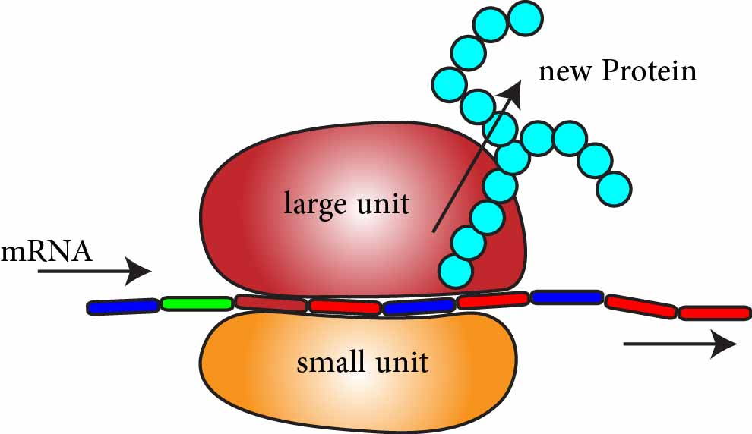
J. The Ribosomes
The ribosomes are large complex molecular machines that are involved in the synthesis of proteins.
The ribosomes link amino acids together in the order specified by the messenger RNA (which comes from the nucleus). That’s why there are so many ribosomes located on the rough ER.
The ribosome consists of two units, a small one that ‘reads’ the RNA and a large unit that connects individual amino acids into a protein molecule.

Slide 18
K. So, these were all the cellular components that we wanted to discuss!
The major organelles in a cell:
Nucleus
Cell Membrane
Cytoplasm
Endoplasmic Reticulum
Golgi apparatus
Lysosomes
Mitochondria
Cytoskeleton
Ribosomes

