Slide 1
A.2.3. Passive Transport Systems

Slide 2
A. Introduction Transport Systems (1):
1. For a cell to be able to live, there must be communication (=transport) between the intracellular fluid (=the cytoplasm) and the extracellular fluid (= interstitial fluid).
2. Some of these transports are passive and do not require energy. Other transport systems are more complicated and require energy (= ATP).

Slide 3
A. Introduction Transport Systems (2):
3. These are the four major passive transport systems:
    diffusion
    facilitated diffusion
    osmosis
    filtration
4. These are the three major active transport systems:
    pumps (co-transporters, etc.)
    exocytosis / endocytosis
    Phagocytosis
    These will be discussed in the next Power Point.

Slide 4
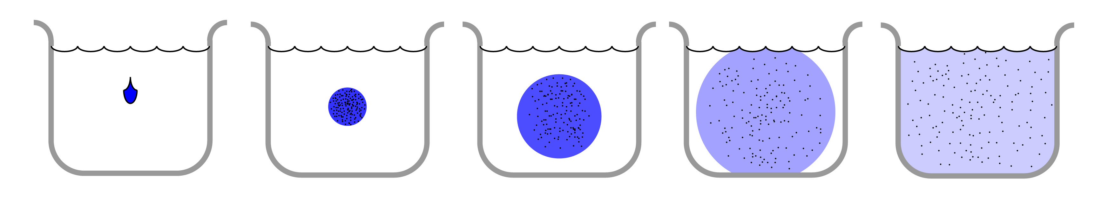
B. What is diffusion? (1)
1.
Diffusion is the process whereby something soluble that is placed in water is ‘automatically’ distributed, dissolved, in that water.
2.
The classic example is a drop of ink that is dropped in a glass of water. If you wait long enough, the ink will be dispersed throughout the water.

Slide 5
B. What is diffusion? (2)
3.
The same is true for sugar, aspirin, oxygen etc. as long as this material can be dissolved in water. If it can not be dissolved then of course diffusion will not take place.
4.
Diffusion takes place because of the Brownian movements of the particles. (Brownian movements are caused by the kinetic energy stored in every particle.
(What is kinetic?)

Slide 6
What is kinetic?
Kinetic energy (from the Greek word ‘Kinein’ = to move) is present in all dissolved particles and molecules. This energy will ‘shake’ these particles all the time. The shaking intensity increases with higher temperatures and slows down at lower temperatures. The shaking stops completely at the absolute zero
(zero Kelvin = -273 ºC = -459 ºF).
www.BasicPhysiology.org A.2.3. Passive Transport Systems slide #6

Slide 7
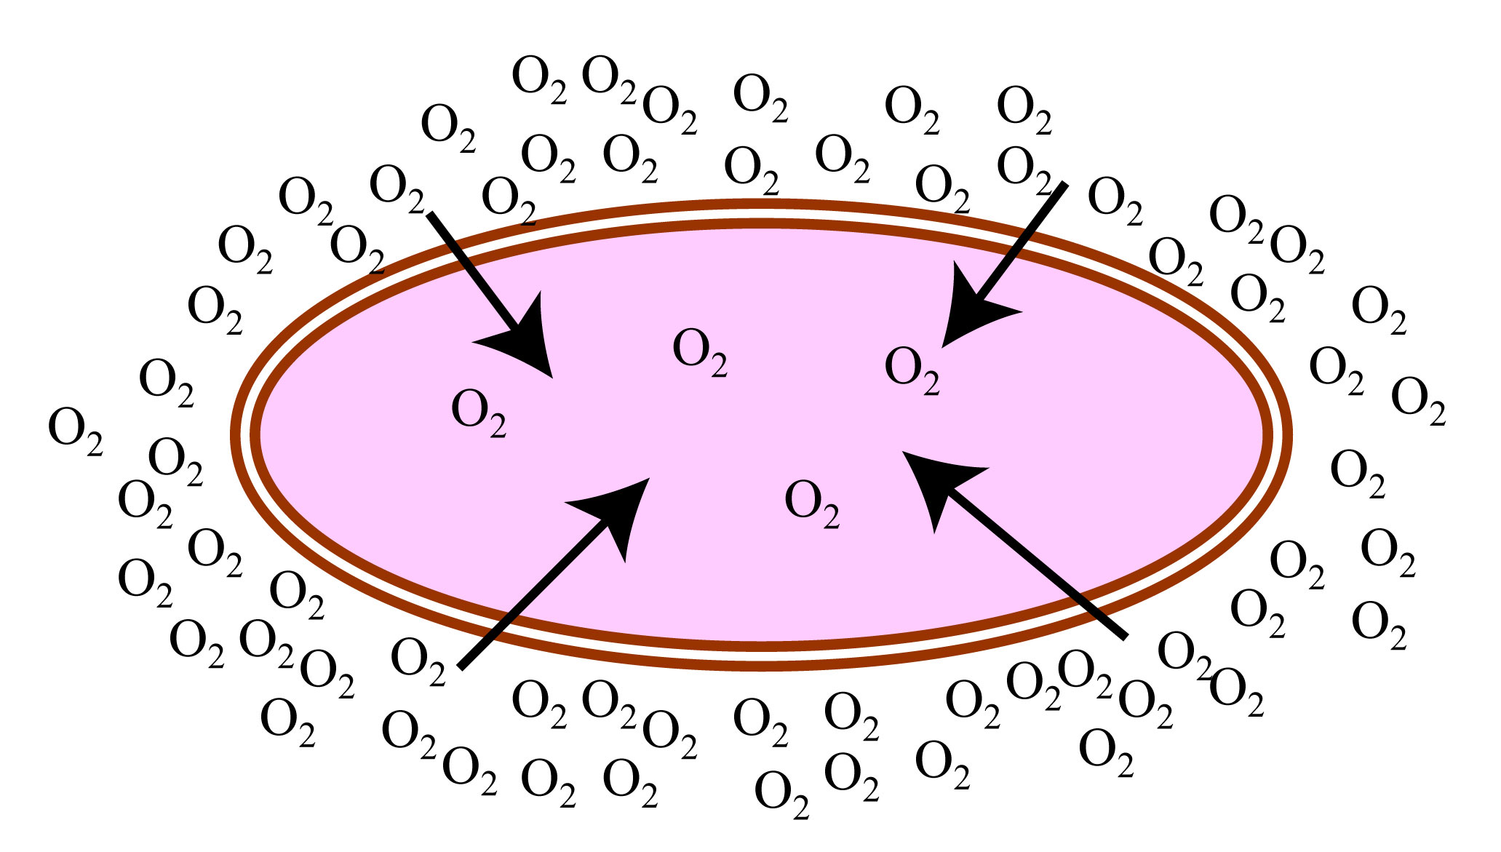
C. Diffusion across the cell membrane: (1)
In the body, diffusion occurs all the time across the cell membranes. This will occur if the concentration of something (=the solute) is higher at one side of the membrane than at the other side, AND if the membrane is permeable for that solute.
For example, oxygen, dissolved in water, can easily cross the membrane. Usually, the oxygen concentration outside the cell is higher outside than inside the cell (because it is used by the cell).

Slide 8
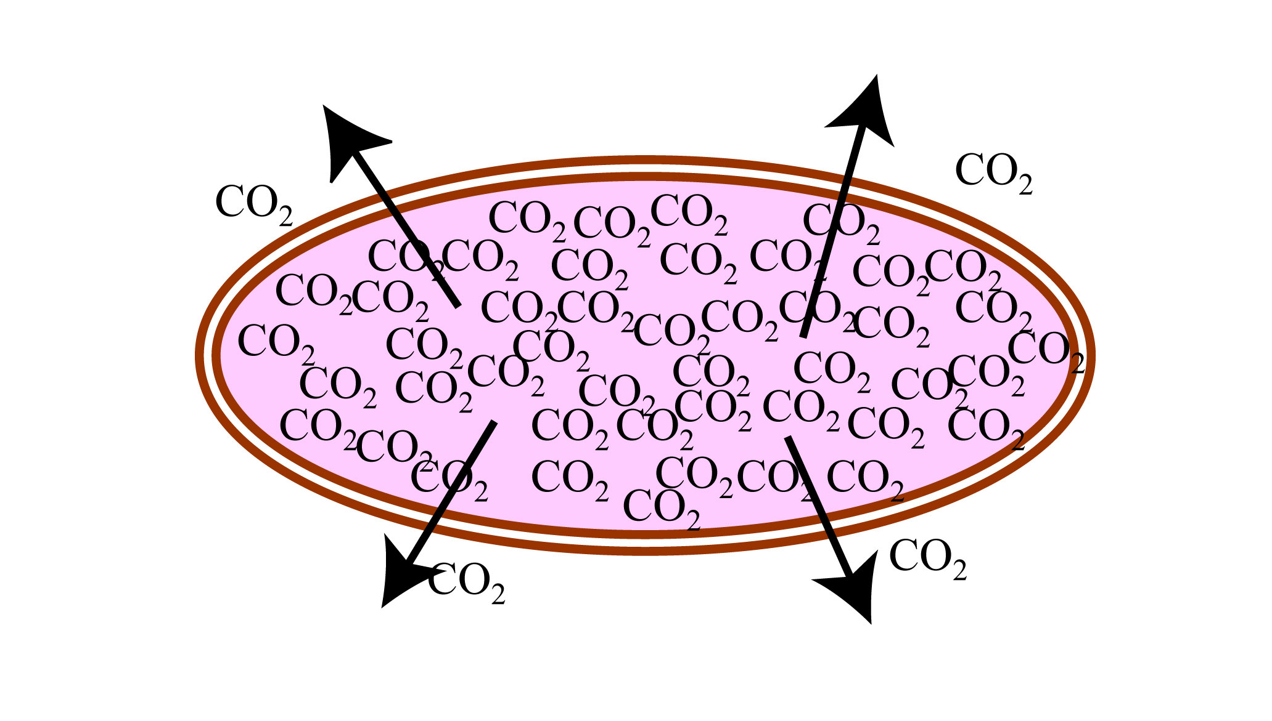
C. Diffusion across the cell membrane: (2)
3. So, if there is a concentration difference for oxygen, then oxygen will diffuse through the membrane and transport itself, automatically, into the cell. This does not require energy.
4. The same thing happens in the opposite direction with the combustion of oxygen; carbon dioxide. This molecule is formed inside the cell (by converting oxygen) and will diffuse out of the cell into the extracellular space.

Slide 9
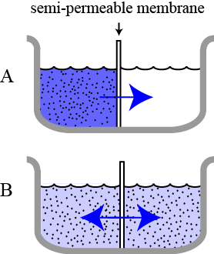
D. Factors that determine the rate of diffusion: (1)
1. In this diagram, a beaker is divided by a membrane. On the left, a solute (blue) has been added to the fluid.
2. As the molecules can pass through the membrane, with time, more and more molecules will pass the membrane to the other side.
3. Eventually, the concentration will be the same in both compartments, left and right of the membrane (light blue in both halves).

Slide 10
D. Factors that determine the rate of diffusion: (2)
4. The factors that determine the speed of diffusion are:
      temperature
      the difference in concentration
      the diffusion distance
      the size of the area of diffusion
5. Increasing the temperature will increase the movements of the particles and this will speed up the diffusion.
6. The higher the difference in concentration, the quicker the diffusion takes place.

Slide 11
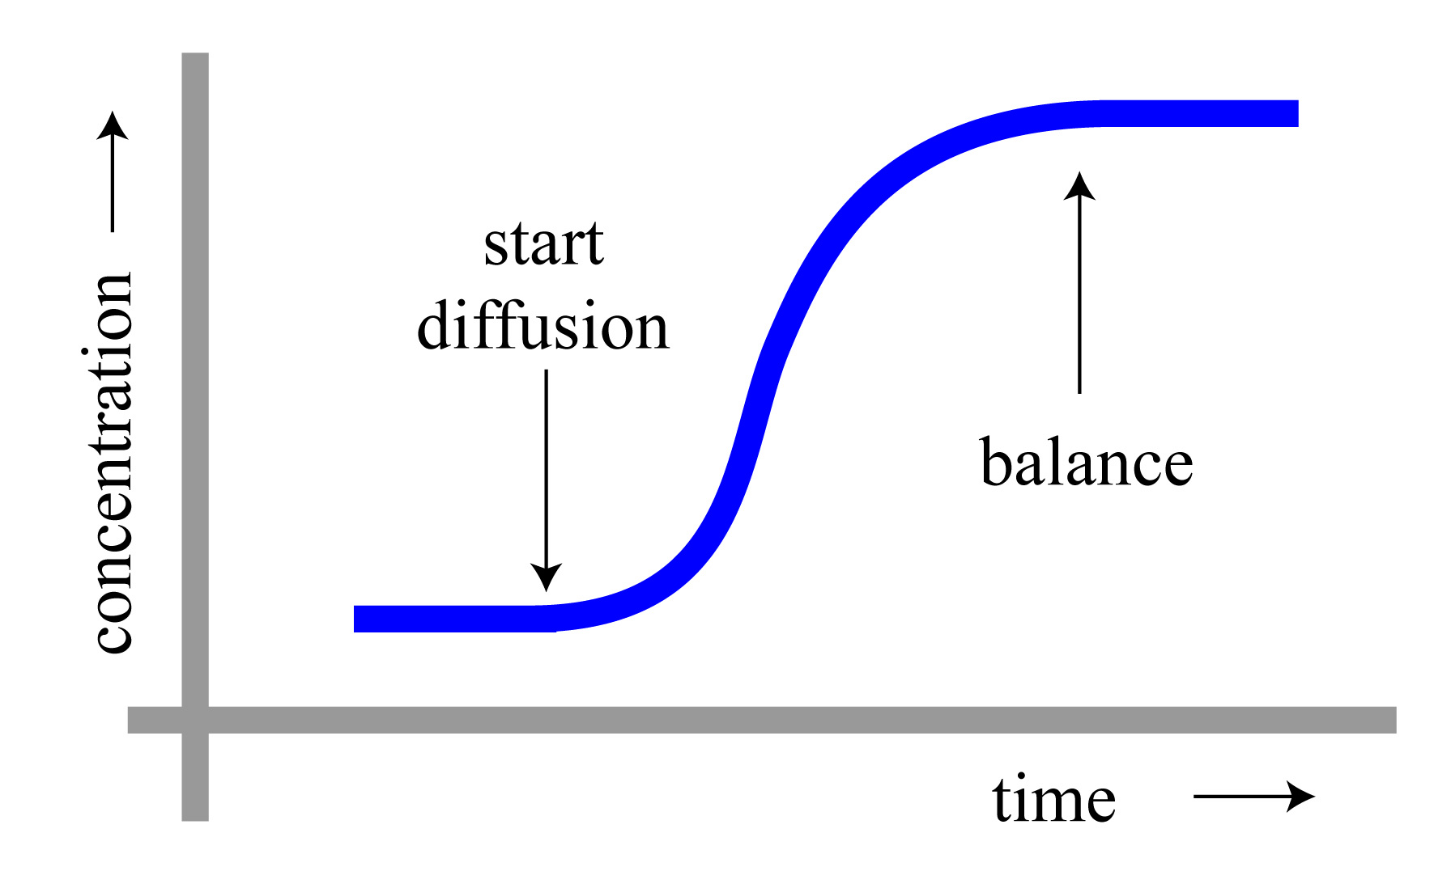
D. Factors that determine the rate of diffusion: (3)
7. The longer the distance between the two compartments (thicker membrane), the longer the diffusion will take place.
8. The graph shows what happens when the diffusion is started. After some time, the concentration has become equal on both sides and net diffusion will be stopped (why ‘net’?)

Slide 12
why ‘net’?
In reality, because the molecules are still moving according to their kinetic energy, some molecules will accidentally cross the membrane and move to the other side. But other molecules that are moving accidentally in the opposite direction will offset this. In other words, the molecules are still moving across the membrane but the net effect is zero.
www.BasicPhysiology.org A.2.3. Passive Transport Systems slide #12

Slide 13
E. Facilitated Diffusion (1):
1. This type of diffusion is performed by special carrier proteins located in the membrane of the cell.
2. So, the membrane, in principle, is not permeable for these molecules but still, they are carried through the membrane by these special carriers.
3. A famous example of facilitated diffusion is the transport of glucose (=sugar) into the cell.
4. Glucose is a molecule that is too big to diffuse through the membrane.

Slide 14
E. Facilitated Diffusion (2):
5. But there is a special carrier in the membrane that can transport glucose, free of energy.
6. This carrier is specific for glucose; it cannot transport anything else.
7. The carrier can transport in both directions; in or out of the cell, depending on the concentration gradient for glucose.
8. But usually, glucose is used (=metabolized) in the cell so the concentration inside is lower, so the transport is usually from outside into the cell.

Slide 15
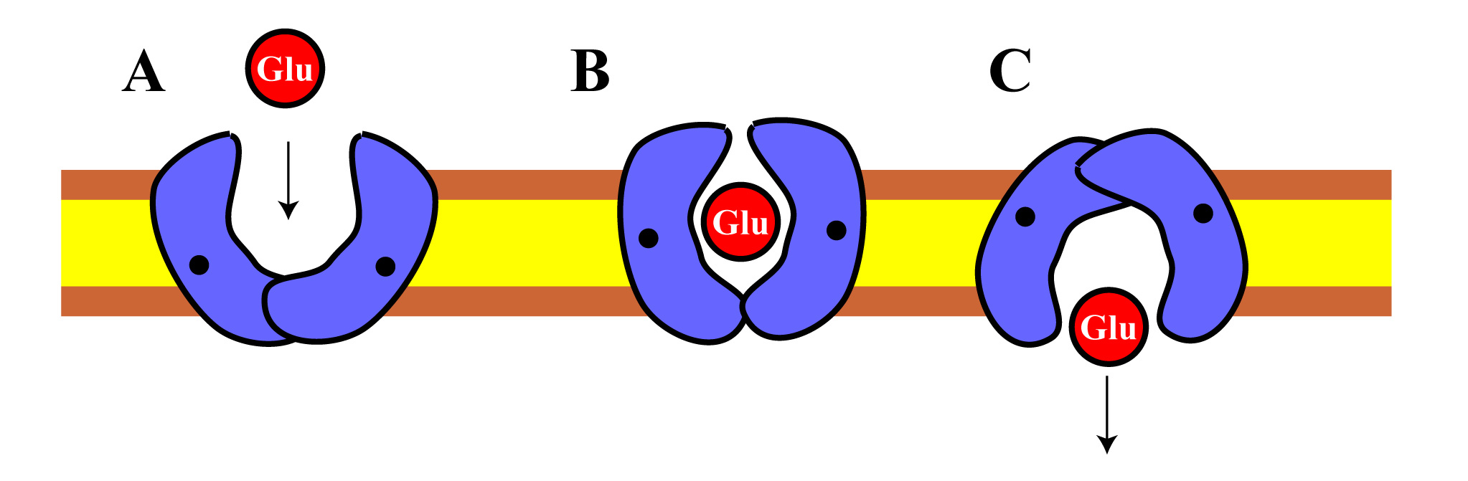
F. Mode of action:
1. When a glucose molecule comes in contact with this carrier, the glucose will couple (=attach) to the carrier.
2. This coupling will change the shape (= the configuration) of the carrier.
3. This configuration change makes it possible for the glucose to ‘diffuse’ to the other side of the membrane.
4. Once the glucose has reached the other side of the carrier, it is released, into the cell and the carrier is free to transport another glucose molecule.

