Slide 1
A.2.5. Mitosis and Meiosis

Slide 2
A. Mitosis (1):
1. The vast majority of all the cells in our body will die at some moment. Before they do that, they often divide into daughter cells to preserve their function and their DNA!
2. The process of a cellular division is called mitosis. This occurs million of times in every single minute that you are alive; blood cells, skin cells, liver cells etc, etc.
3. This process of mitosis is quite complicated and consists of several steps:
Interphase
Prophase
Metaphase
Anaphase
Telophase
www.BasicPhysiology.org A.2.5. Mitosis and Meiosis slide #2

Slide 3
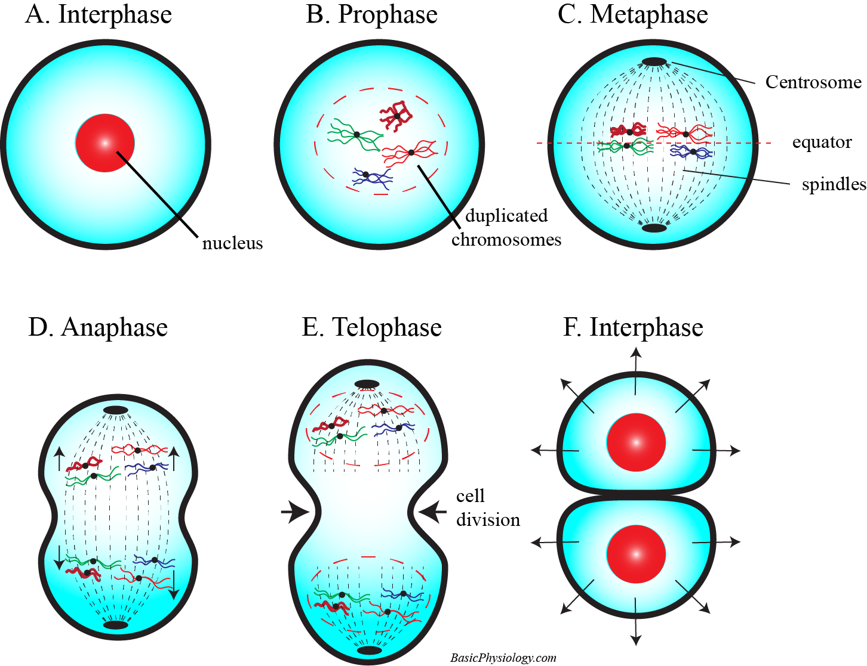
A. Mitosis (2):
1. The Prophase is the stage when:
The membrane of the nucleus gradually disappears
The chromosomes become visible. Every chromosome pair is coupled to each other at a centromere.
Cellular structures called centrioles (also called centrosomes) appear and stretch towards the two poles in the cell.
2. The Metaphase is the phase when the chromosomes move towards a row located in the centre, the equator, of the cell. In addition, spindle fibres connect every chromosome to the centrioles.
www.BasicPhysiology.org A.2.5. Mitosis and Meiosis slide #3

Slide 4
A. Mitosis (3):
1. In the Anaphase, the centromeres are split and the spindles pull each chromosome towards the centrioles at one side of the cell: 2 x 24 chromosomes to one side, another 2 x 24 to the other side of the cell.
2. In the Telophase, the spindle fibres disappear, a nucleus membrane is formed around each chromosome cluster and the cell membrane squeezes inside the cell to develop two separate cells.
3. When the cellular membranes have formed and divided the two cells from each other, both daughter cells now enter their own interphase.
www.BasicPhysiology.org A.2.5. Mitosis and Meiosis slide #4

Slide 5
B. The names of the mitosis phases (1):
1. The names of the different phases during mitosis may sound difficult and confusing. Let’s try to explain them!
2. Interphase: this is not so difficult; the phase between the subsequent events (= the mitosis!).
3. Prophase: from the Greek word “Pro”, which means “before”. The cell starts to get ready for the mitosis; the nucleus membrane disappears, the centrioles appear etc.
www.BasicPhysiology.org A.2.5. Mitosis and Meiosis slide #5

Slide 6
B. The names of the mitosis phases (2):
4. Metaphase: from the Greek word “Meta” which means “adjacent”. So, in this phase, all the chromosomes are aligned together (‘adjacent’) to each other along the equatorial plane.
5. Anaphase: from the Greek word “Ana”, which means “Up”. This is the phase when the replicated chromosomes are split and the ‘daughter’ chromosomes are pulled, by the spindle fibres, towards the opposite poles of the cell.
6. Telophase: from the Greek word “Telo” which means the “end”, as this is the final stage of the mitosis, when the nuclear envelope is re-assembled, the centrioles and spindle fibres are disassembled.
www.BasicPhysiology.org A.2.5. Mitosis and Meiosis slide #6

Slide 7
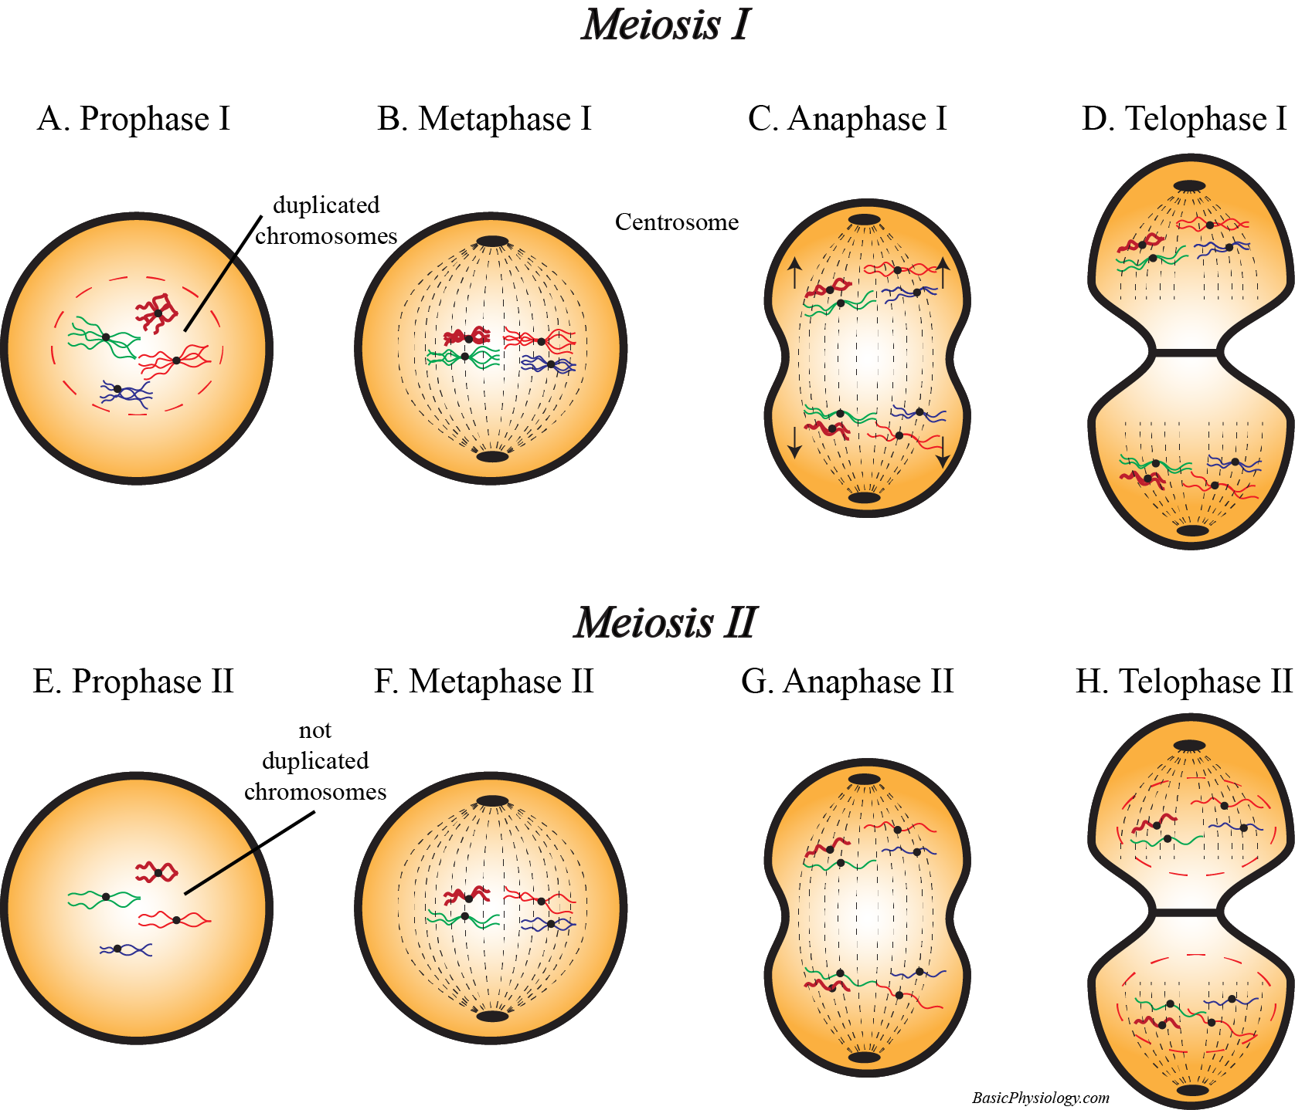
C. Meiosis (1):
1. There is however one type of mitosis which is ‘slightly’ different from mitosis but crucial for our survival! This is the cellular division of our ‘sex’ cells; our gametes. These are the sperm cells (in males) and the oocytes (in females).
2. As you may know/remember, life starts when a sperm cell and an oocyte ‘merge’ together to form an embryo. If their chromosomes were simply put together into the cell of the new embryo, his (or her!) cells would contain 2 x 2 x 24 chromosomes! That is impossible. (Why not?)
3. Therefore, the number of chromosomes has to be reduced (halved) before fertilization occurs. This is (one of) the purposes of meiosis.
www.BasicPhysiology.org A.2.5. Mitosis and Meiosis slide #7

Slide 8
C. Meiosis (2):
4. Meiosis actually consists of two parts, or two steps, called “meiosis I” and “meiosis II”. Each meiosis contains the same phases as during mitosis: prophase, metaphase, anaphase and telophase.
5. Meiosis I is very similar to a normal mitosis whereby the number of chromosomes is duplicated. Then, when the cells divide into two daughter cells, the number of chromosomes is still 2 x 24 in each cell.
6. The purpose of meiosis I is to exchange the genes (=DNA) across their chromosomes during the actual duplication. This is called “crossing-over” or “recombination”. In this way, the daughter cells are actually genetically different from each other!
www.BasicPhysiology.org A.2.5. Mitosis and Meiosis slide #8

Slide 9
C. Meiosis (3):
7. After Meiosis I, Meiosis II will start. Now, in contrast to all other divisions, the chromosomes are NOT duplicated.
8. So, when the daughter cells are created, each cell, in its nucleus, contains only one set of chromosomes: 1 x 24!!
9. This is SO important that we have names for cells that have one or two sets of chromosomes; “diploid” and “haploid”.
10. Diploid means two sets of chromosomes while Haploid means one set. Therefore, sperm cells and oocytes are haploid, while all other cells in the body are diploid.
www.BasicPhysiology.org A.2.5. Mitosis and Meiosis slide #9

Slide 10
Why not?
As you may know/remember, life starts when a sperm cell and an oocyte ‘merge’ together to form an embryo. If their chromosomes were simply put together into the cell of the new embryo, his (or her!) cells would contain 2 x 2 x 24 chromosomes! That is impossible. (Why not?)
Why not? Suppose that the numbers of chromosomes is not halved during meiosis II. Then the daughter cells will each get 2x2x24 chromosomes (total of 96). In the next child, this will become 2x2x2x24 (=192), and in the next ‘generation’ 2x2x2x2x24 (=284), etc etc. Simply impossible!
www.BasicPhysiology.org A.2.5. Mitosis and Meiosis slide #10

