Slide 1
A.3.6. The Electrical Synapse
Introduction:
In previous pages, we discussed how the action potential propagates along the membrane in one single cell. But action potentials can also propagate from one cell to the next cell. On this page, we will discuss one type of propagation from one cell to the next; the electrical ‘synapse’.

Slide 2
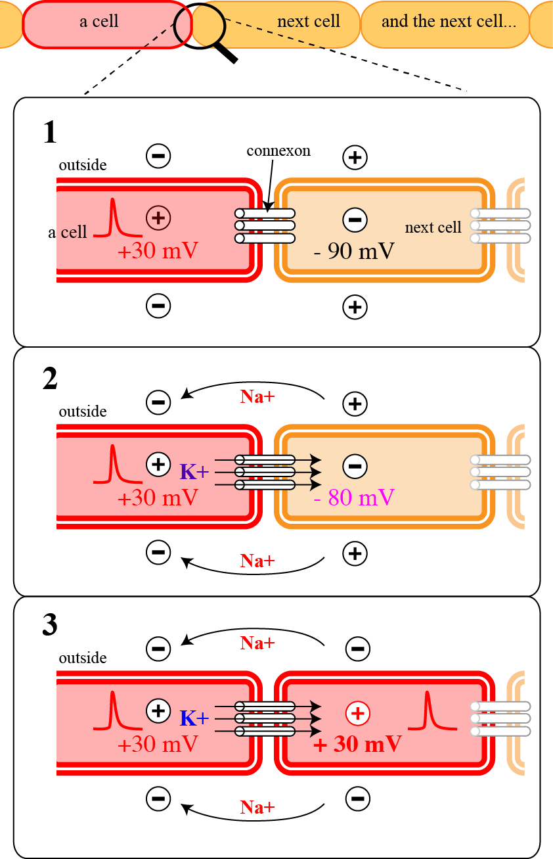
A. Function of an electrical synapse: (1):
1. In the ‘electrical’ synapse, there is a special structure joining (or ‘bridging’) neighboring cells; the connexons.
2. These connexons are molecules shaped like long little tubes that run from one cell to the next; small ions, such as K⁺, can flow through them.
3. In this diagram, the two cells are connected with several connexons.
4. An action potential has been initiated in the left cell (red cell). The inside of the cell is therefore positive (+30 mV) and the outside is negative.
www.BasicPhysiology.org A.3.6. The Electrical Synapse slide #2

Slide 3
A. Function of an electrical synapse: (2):
5. The next cell (right) is still in the resting phase and the membrane potential inside is therefore negative (brown), usually –90 mV.
6. Outside the cell, in the extracellular fluid, the situation is very similar to that during electrical propagation along a membrane.
7. Therefore, sodium ions, which are positive, will be attracted by the depolarized membrane and flow away from the resting cell towards the excited cell.
8. Inside the excited cell, the potassium ions are attracted to the negative resting potential in the resting cell (right). These ions can flow into that cell through the tubular connexons.
www.BasicPhysiology.org A.3.6. The Electrical Synapse slide #3

Slide 4
A. Function of an electrical synapse: (3):
9. Because of this external and this internal ion flow, the membrane potential in the resting cell will decrease (in this case from –90 to –80 mV; panel 2).
10. This depolarization will reach threshold and an action potential is initiated in the next cell (panel 3).
In Summary:
An action potential in one cell, by inducing a flow of potassium ions from this cell to the next through the connexons, will induce a new action potential in the next cell. The action potential propagates therefore in steps from one cell to the next.
www.BasicPhysiology.org A.3.6. The Electrical Synapse slide #4

Slide 5
B. Important notes: (1):
1. This process is nearly as fast as the propagation along a membrane and much faster than transmission in a chemical synapse (see next presentation).
2. That is because in an electrical synapse, the speed depends on the flow of ions through the connexons.
3. As with propagation in a single cell, the direction of propagation is bi-directional. If cell 2 had been activated first, then the action potential would as easily have propagated from the second to the first cell (from right to left in the panel).
www.BasicPhysiology.org A.3.6. The Electrical Synapse slide #5

Slide 6
B. Important notes: (2):
4. Also important: the ratio of propagation is 1:1. This means that propagation is always successful (in a normal tissue). If the first cell is activated, then, after a small delay, the second cell will also be activated.
5. It is important to realize that this electrical propagation from one cell to another is only possible if the connexons are open.
www.BasicPhysiology.org A.3.6. The Electrical Synapse slide #6

Slide 7
B. Important notes: (3):
6. If the connexons are not open, then there will be no intracellular current flow from one cell to the next, and therefore the threshold will not be reached and propagation is then stopped. This is not normal but can occur in pathological situations.
7. In the brain, chemical synapses are more common than electrical synapses but in other tissues, especially in the heart and in smooth muscles, electrical synapses are very common.
www.BasicPhysiology.org A.3.6. The Electrical Synapse slide #7

