Slide 1
A.4.1. The Muscle Cell
Introduction: (repeat of previous presentation)
In this Basic Physiology chapter, we discuss two types of cells in the body that demonstrate several basic physiological principles that are very useful to know and understand before starting the study of specific organ systems.
These are a) the nerve cells and b) the muscle cells.
In this and the next slides, we will concentrate on the physiology of the muscle cells.

Slide 2
A. What is a muscle cell? (1)
1. A muscle cell is a cell that, when stimulated, contracts.
2. The muscle cell is part of a whole muscle which, when stimulated, contracts. This makes all kind of things happen in the body.
3. There are three types of muscles in the body:
the skeletal muscle
the cardiac muscle
c. the smooth muscle
www.BasicPhysiology.org A.4.1.. The Muscle Cell slide #2

Slide 3
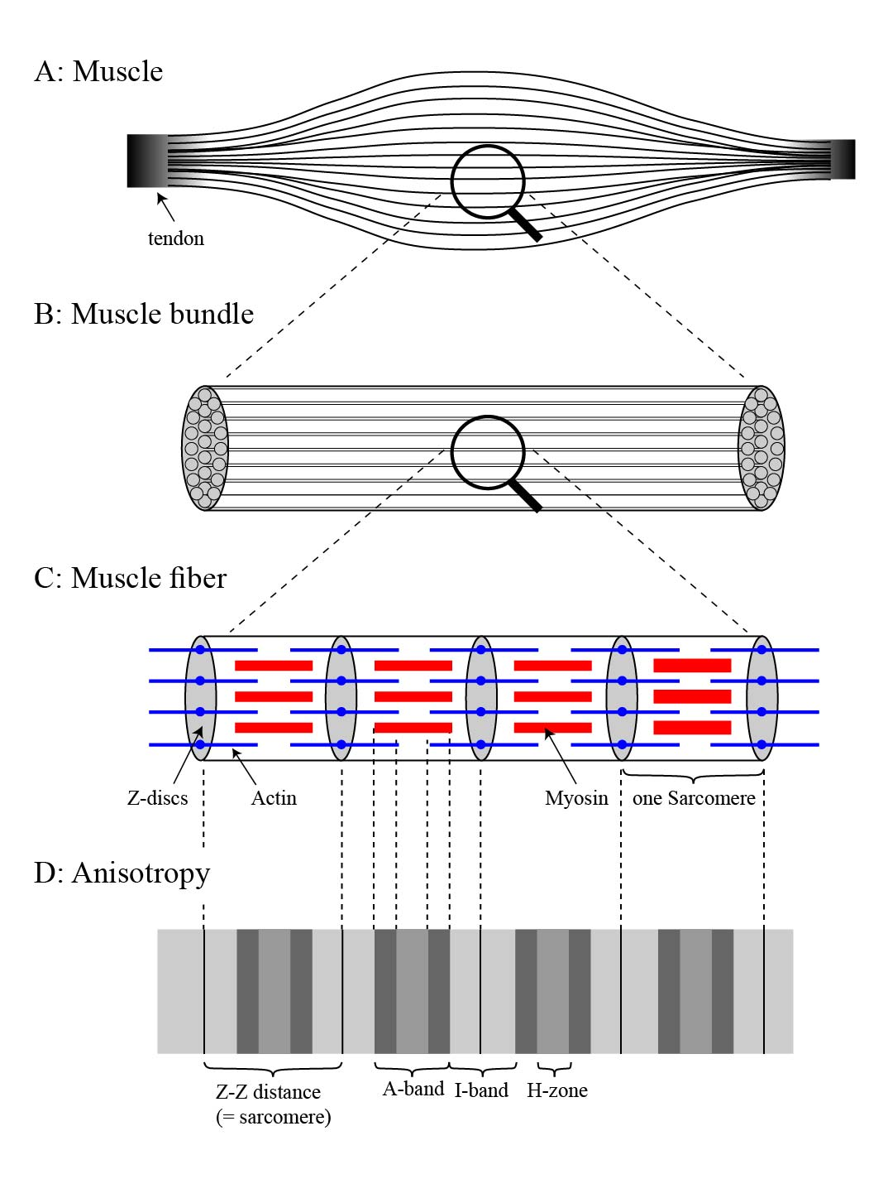
B. The skeletal muscle cell (1)
1. A skeletal muscle is typically long and attached to two or more tendons. The tendons, in turn, are attached to the bones of the skeleton.
2. The muscle consists of elongated cells grouped together by layers of connective tissues
3. The tendons and the connective tissues are all connected to each other and surround the working muscle cells.
www.BasicPhysiology.org A.4.1.. The Muscle Cell slide #3

Slide 4
B. The skeletal muscle cell (2)
4. One single muscle fibre (= cell) can be very long (centimetres) and very thin (10-100 microns).
5. One muscle cell contains:
several nuclei (pleural of nucleus)
one motor-end plate (for connecting the motor nerve to the muscle cell)
several mitochondria for producing ATP (= energy for the contraction)
> 1000 sarcomeres arranged along the cell.
www.BasicPhysiology.org A.4.1.. The Muscle Cell slide #4

Slide 5
B. The skeletal muscle cell (3)
6. The sarcomere is essentially the working unit of the muscle:
A sarcomere runs from one Z-disk to the next Z-disk
Sarcomeres contain two type of molecules (=myofilaments): actin and myosin
The actin molecules are attached to the Z-disks
The myosin molecules are arranged in a regular pattern between the actin molecules
www.BasicPhysiology.org A.4.1.. The Muscle Cell slide #5

Slide 6
C. Striation (= Anisotropy) (1)
1. When viewed under the microscope, the skeletal muscle shows a typical striated pattern of light- and dark bands. This striation is caused by the structure of the sarcomere.
2. There are two bands; the dark A-band and the light I-band.
3. The dark A-band corresponds to the length of the myosin molecules (these are thick molecules and therefore less light is transmitted though them; hence the darkness as seen under the microscope).
4. The lighter I-band corresponds to the length of the actin molecules, which are thinner and therefore allow more light to pass through.
www.BasicPhysiology.org A.4.1.. The Muscle Cell slide #6

Slide 7
C. Striation (= Anisotropy) (2)
5. The Z-disk is hardly visible in the microscope (often called Z-line
6. Because the Z-line is hardly visible, the I-band stretches from one A-band to the A-band in the next sarcomere.
7. Some people have also noticed and described a somewhat lighter zone in the middle of the A-band; called the H-zone. This is the zone in which the myosin molecules do not overlap with the actin molecules (and hence a little bit more light is transmitted through this small region).
8. All this is not terribly important except for the fact that some teachers like to ask what would happen with these bands when contraction of the sarcomere occurs (see next presentation).
www.BasicPhysiology.org A.4.1.. The Muscle Cell slide #7

Slide 8
D. The cardiac and the smooth muscle cell
1. The cardiac and smooth muscle cells differ in several important ways from the skeletal muscle cells.
2. The cardiac muscle is also striated whereas the smooth muscle is not. Hence its name; smooth!
3. More slides on the cardiac and smooth muscle cells are available at other presentations and on the website.
www.BasicPhysiology.org A.4.1. The Muscle Cell slide #8

