Slide 1
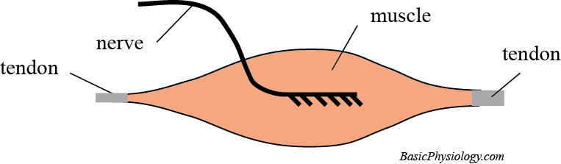
A.4.5. Contraction Types
Purpose: To make a muscle contract in a sensible and useful manner.
Definitions and Structural components required:
A skeletal muscle
A nerve innervating this muscle
Tendons at both ends of the muscle
www.BasicPhysiology.org A.4.5. Contraction Types slide #1

Slide 2
B. Muscle Length and Muscle Tone:
1. When a muscle contracts, two things can change in that muscle: the length of the muscle and/or the tone of the muscle.
2. But what is tone?
A change in the length of the muscle is easy to understand but tone is maybe more difficult as most people don’t know the meaning of the word “tone”.
3. The easiest way to sense tone is to feel your muscles (such as your biceps in the upper arm) when it is relaxed and when it is contracting.
4. When contracting, the muscle feels ‘stronger’. That is the tone.
www.BasicPhysiology.org A.4.5. Contraction Types slide #2

Slide 3
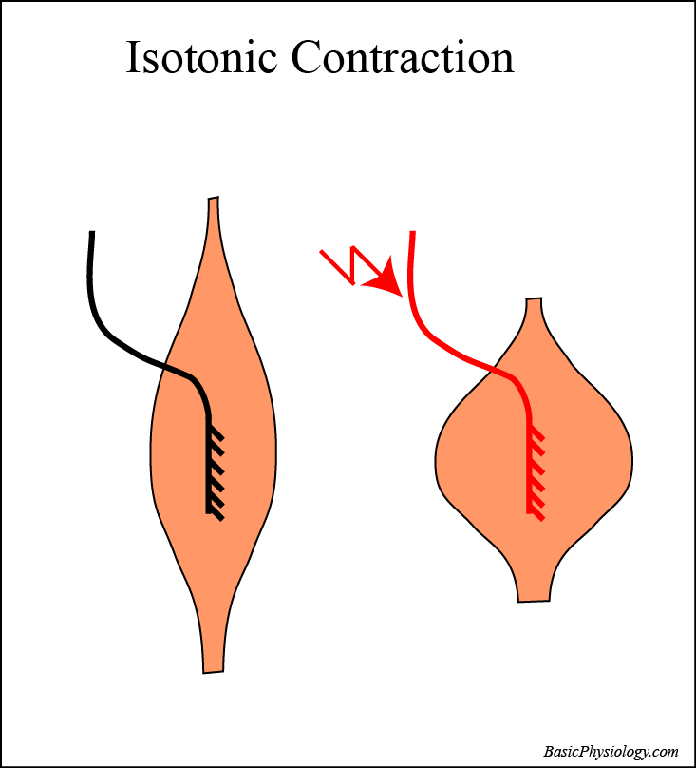
C. Types of Contractions (1):
1. Isotonic Contraction
The most simple contraction is when the muscle contract without any or little attachment. The length of the muscle is then reduced but the tone has not changed. This is called isotonic (= same tone).
www.BasicPhysiology.org A.4.5. Contraction Types slide #3

Slide 4
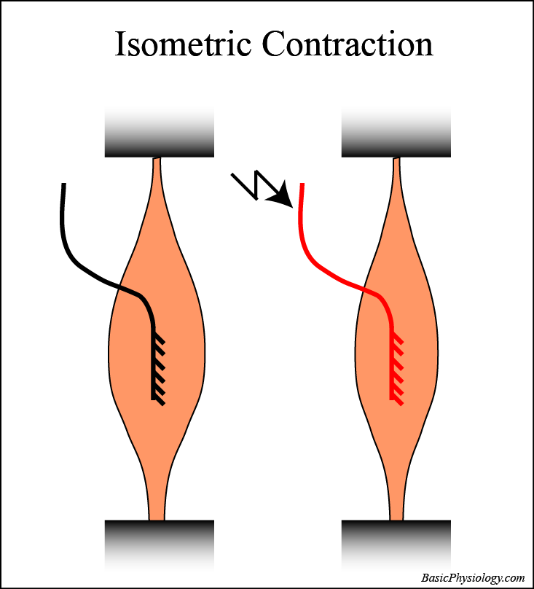
C. Types of Contractions (2):
2. Isometric Contraction
The opposite situation occurs when the muscle is fixed at both ends by its tendons. Then, when contraction occurs, the muscle cannot change its length but the tone will increase. This is called isometric (iso = same; metric = length).
www.BasicPhysiology.org A.4.5. Contraction Types slide #4

Slide 5
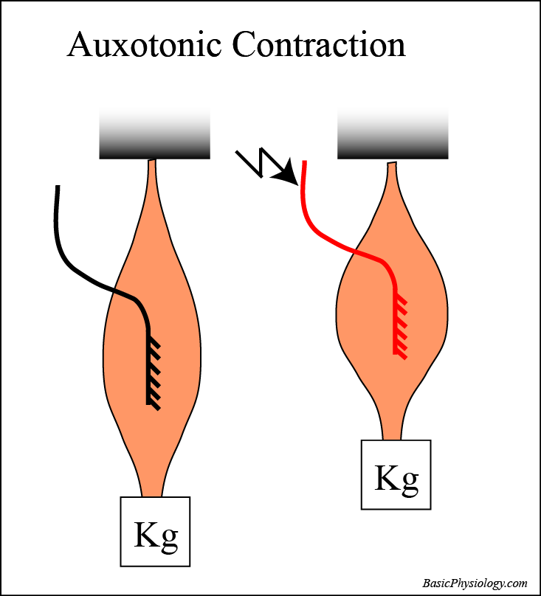
C. Types of Contractions (3):
3. Auxotonic Contraction
Most contractions in daily life show some change in length and some change in tone; these are called auxotonic.
www.BasicPhysiology.org A.4.5. Contraction Types slide #5

Slide 6
C. Types of Contractions (4):
4. An example of an isotonic contraction is ‘waving your hand’ (like the royalties!) or waving your finger at a bad student!
5. An example of an isometric contraction is pushing your hand and arms against a wall (which will not budge), or, carrying a football in your hand with your arm flexed.
6. Since most daily contraction involves both changes in tone and in length, nearly all contractions are auxotonic.
www.BasicPhysiology.org A.4.5. Contraction Types slide #6

Slide 7
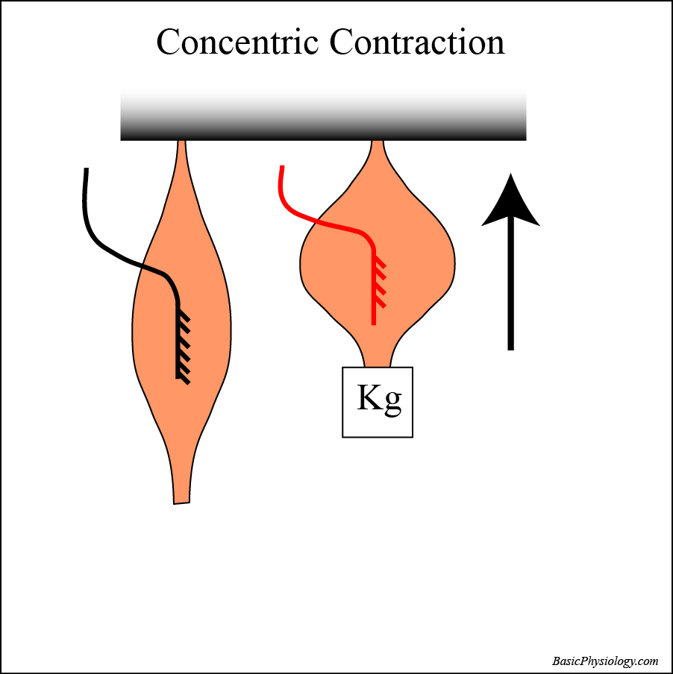
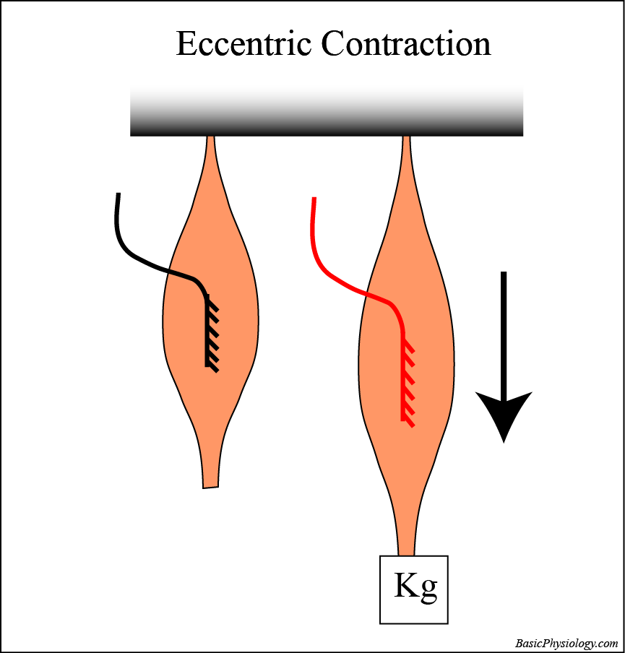
D. Another type of Contraction:
1. Concentric Contractions
Usually, when a muscle contracts, the length of the muscle decreases; this is called a concentric contraction. This is often used to flex a joint. For example, when you lift a suitcase from the floor.
2. Eccentric Contractions
But sometimes, you use your muscles to control extension, such as when you carefully lower a suitcase back onto the floor; then the muscle length increases while contracting at the same time. This is called an eccentric contraction.
www.BasicPhysiology.org A.4.5. Contraction Types slide #7

Slide 8
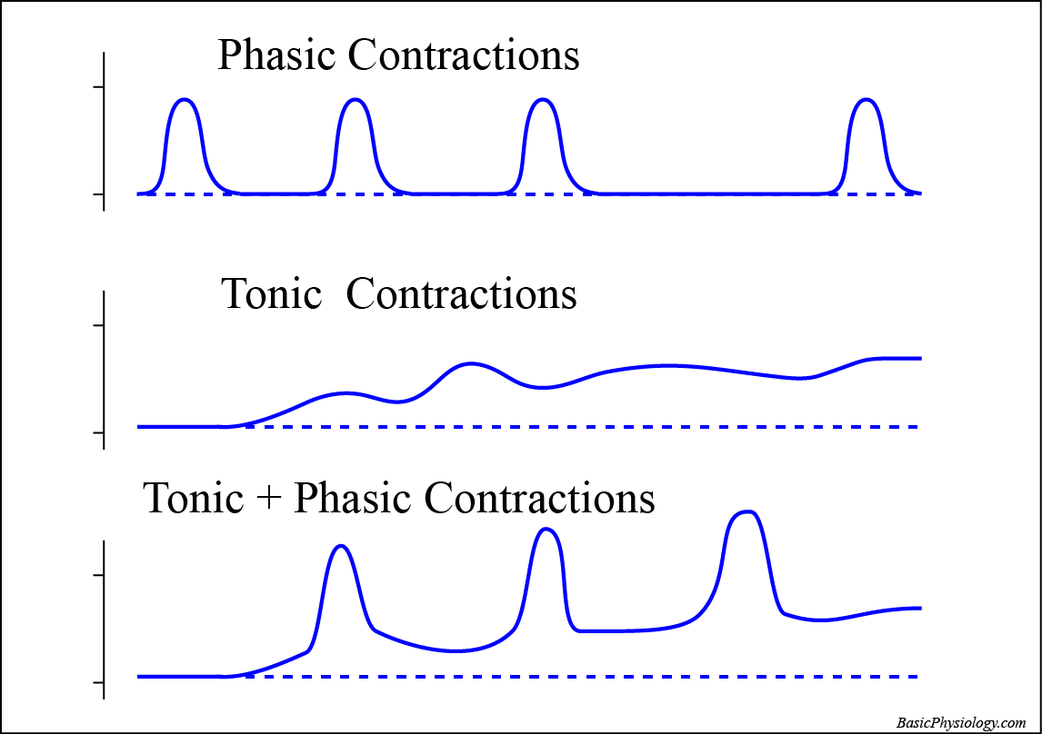
E. Another way is to look at the rhythm of the contractions (1):
Phasic Contractions:
When the muscle contracts and relaxes in a rhythmic manner; this is called phasic contraction. This occurs for example when you are walking. Your leg muscles alternatively contracts and relax while you walk.
2. Tonic Contractions:
The opposite situation occurs when the muscle is contracting all the time but only varies in tone. This is called tonic contraction. Typical muscles that perform tonic contractions are the muscles in the back. They hold the vertebra column (and therefore your back) upright all the time.
www.BasicPhysiology.org A.4.5. Contraction Types slide #8

Slide 9
E. Another way is to look at the rhythm of the contractions (2):
3. Tonic + Phasic contractions
Many muscles, depending upon the situation, can also perform tonic and phasic contractions simultaneously. For example, when you hold a ball in your hand with your elbow bend at ninety degrees (tonic contraction) and you also, at the same time, move your lower arm up and down (phasic contraction).
www.BasicPhysiology.org A.4.5. Contraction Types slide #9

