Slide 1
A.4.6. Motor Units
Introduction: The motor unit is the only connection between the central nervous system (= the brain) and the skeletal muscles.
www.BasicPhysiology.org A.4.6. Motor Units slide #1

Slide 2
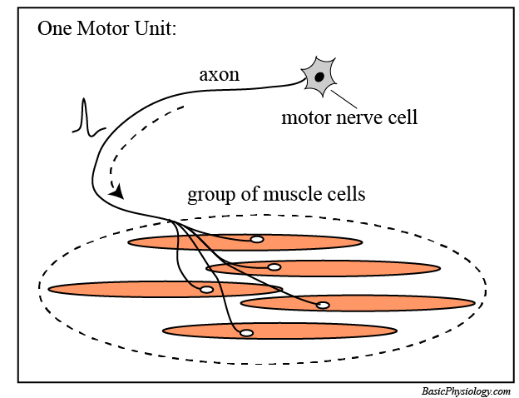
A. Definitions and Structural components required (1):
A motor unit consists of:
a motor nerve cell which is located in the spinal cord.
an axon that goes from the nerve cell to a skeletal muscle.
3. several skeletal muscle fibres that are innervated by this particular motor axon.
www.BasicPhysiology.org A.4.6. Motor Units slide #2

Slide 3
A. Definitions and Structural components required (2):
2. The axon can be very short or very long, depending upon the distance from the spinal cord to the muscle.
For example, in the case of the muscles in your big toe, the axon has to go through the length of your leg; about one meter! (approx. 3 feet)
3. In the figure above, the motor nerve is connected to 5 muscle fibres. This is actually a small motor unit. Usually, a motor unit will connect (=innervate) many more muscle fibres. Typically, a few hundred to a few thousand muscle fibres (=cells) are connected to one single motor nerve.
www.BasicPhysiology.org A.4.6. Motor Units slide #3

Slide 4
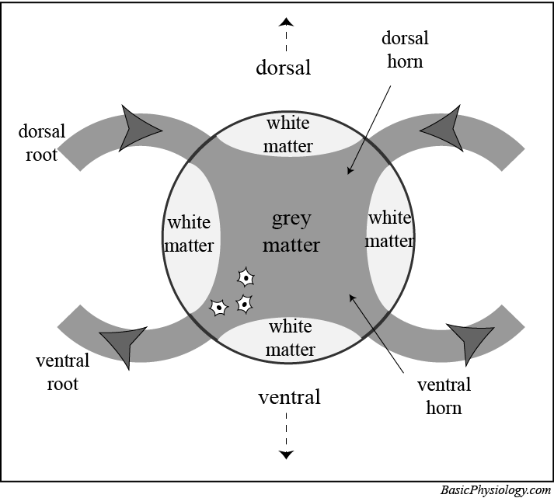
B. A bit of information about the spinal cord: (1):
1. The spinal cord is a part of the central nervous system. It is located in the vertebral column and runs from the head down to the sacral region (= your butt!).
2. In this cross section (figure), the spinal cord consists of two parts; the grey matter and the white matter.
3. Make sure you understand the orientation of the spinal cord in this cross section; the upper part is dorsal (pointing towards the back) and the lower part is ventral (pointing towards the front).
www.BasicPhysiology.org A.4.6. Motor Units slide #4

Slide 5
B. A bit of information about the spinal cord: (2):
4. Inside the spinal cord, there are two types of tissues; the white matter and the grey matter (matter = tissue).
5.The white matter consists of myelinated nerve fibres. They form tracks that go up (= to the brain) and down (=from the brain). It is white because of the myelination.
The grey matter consists mainly of nerve cell bodies (= soma), hence the greyish colour.
6. The spinal cord is connected to the body by the spinal roots.
www.BasicPhysiology.org A.4.6. Motor Units slide #5

Slide 6
B. A bit of information about the spinal cord: (3):
7. Between every pair of vertebra there are two roots coming into the spinal cord (at the dorsal side) and two roots going out of the spinal cord (at the ventral side).
8. The dorsal roots (incoming) contain the axons from sensors in the body. The ventral roots (outgoing) contain the axons that are connected to the ‘effectors’ in the body, mainly muscles and glands.
9. Therefore the incoming nerves are called sensory nerves and the outgoing nerves are called motor nerves.
www.BasicPhysiology.org A.4.6. Motor Units slide #6

Slide 7
B. A bit of information about the spinal cord: (4):
10. Those parts of the grey zones in the spine that are close to the in- or outgoing roots are called the horns.
11. Because of the Ventral-Dorsal orientation, these horns are therefore called respectively the ventral horns and the dorsal horns.
12. The ventral horn is the home of the motor nerve cell bodies (that is their soma). The axons of these cells go out of the spinal cord through the ventral roots and to the muscle cells that they innervate.
www.BasicPhysiology.org A.4.6. Motor Units slide #7

Slide 8
C. A bit more information about the motor unit:
1. A motor unit does NOT innervate ALL the muscle fibres in a muscle. If that were the case, every action potential from this motor neuron would cause a massive and unregulated contraction of the whole muscle; i.e. a huge twitch.
2. A motor unit typically innervates 10-1000 muscle fibres. This depends on the type of muscles. Small muscles that are very delicate (like the small muscles in the fingers) innervate small size motor units (50-500 muscle fibres) whereas large muscles that do not need a lot of regulation (such as the large muscles in the legs) have motor units of 1,000 to 10,000 muscle fibres.
www.BasicPhysiology.org A.4.6. Motor Units slide #8

Slide 9
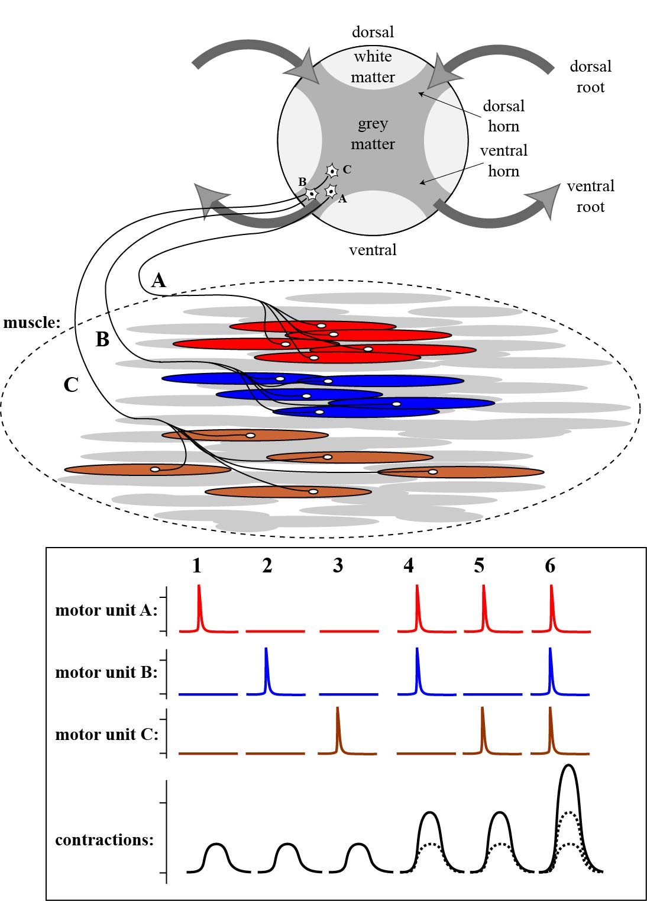
D. How does a motor unit work? (1):
1. An example of several motor units is shown in the figure. In this case, three motor units are shown (three motor neurons A, B and C and their respective muscle fibres; red, blue and brown), all located in the same muscle.
2. If motor neuron A fires, then the red muscle fibres will contract. If motor neuron B or C fires, then the blue or the brown fibres will contract. This is shown in the graph in situations 1, 2 and 3.
www.BasicPhysiology.org A.4.6. Motor Units slide #9

Slide 10
D. How does a motor unit work? (2):
3. If two neurons fire simultaneously, (situations 4 and 5) then both groups of muscle fibres will contract, causing a stronger contraction. This effect is called summation. If all three neurons fire simultaneously (situation 6), then the contraction amplitude will further increase.
4. You must realize that the motor neuron is the boss. The muscle fibres have absolutely no say in this. If the motor neuron induces an action potential, then that action potential will always propagate to the muscle fibres that are innervated by that axon.
www.BasicPhysiology.org A.4.6. Motor Units slide #10

Slide 11
D. How does a motor unit work? (3):
5. This is because transmission across the motor-end plate, the connection between the nerve axon and the muscle cell is always successful. Therefore, if there is an action potential in the motor nerve, then there will always be action potentials travelling towards the connected muscle fibres and therefore contraction in those fibres. You could say that the muscle fibres are the ‘slaves’ of the motor neurons.
www.BasicPhysiology.org A.4.6. Motor Units slide #11

Slide 12
E. Spatial and Temporal Summation:
1. The summation discussed above, in which several motor neurons work together to induce stronger contractions, is called spatial summation. The term “spatial” refers to the fact that muscle fibres from different regions in the same muscle are activated together and contract together.
2. In a previous presentation, we have also discussed a different type of summation (see: Twitch & Tetanus). In that situation, one single motor unit was repeatedly activated. This also induced summation and this type of summation can now be called temporal summation (=summation in time; ‘tempor’ = time).
3. In daily life, both types of summation, spatial and temporal, are simultaneously active and work together to perform smooth contractions and movements of our skeleton.
www.BasicPhysiology.org A.4.6. Motor Units slide #12

Slide 13
F. Why do we need motor units (1)? Would it not be simpler if a motor neuron would innervate and activate one single muscle fibre?
1. If every muscle fibre were connected to its own nerve cell, then there would be as many motor neurons as there are muscle fibres in our body.
2. The problem is that there are too many muscle fibres in the body. If every muscle fibre had its own motor neuron, then there would be an enormous increase in the number of motor neurons and hence in the size of the spinal cord. The spinal cord would then be very much larger (wider) than it now is.
www.BasicPhysiology.org A.4.6. Motor Units slide #13

Slide 14
F. Why do we need motor units (2) ? Would it not be simpler if a motor neuron would innervate and activate one single muscle fibre?
3. So, to be more efficient, one motor neuron typically innervates 100-10,000 motor fibres.
4. In fact, the ventral horns (those that contain the motor neurons) are indeed larger in two areas along the spinal cord; namely at those locations where the motor neurons innervate the upper and the lower limbs. In those locations, more motor neurons are required to innervate more muscles, in the limbs, then in other parts of the body (such as thorax or abdomen).
www.BasicPhysiology.org A.4.6. Motor Units slide #14

Slide 15
G. A few more notes on motor units (1):
1. Motor units provide for a more efficient way of stimulating and contracting muscles. If the brain needs a lot of control to perform delicate movements, then there will be many neurons involved in this contraction and hence the motor units will be small (less muscle fibres connected to each motor neuron).
2. However, if in some muscles, the brain does not need a lot of control, then less motor neurons will be dedicated to these muscles.
3. This is often the case in large muscles such as in the legs or in the abdomen. Motor neurons that control these muscles often connect to thousands of muscle fibres each.
www.BasicPhysiology.org A.4.6. Motor Units slide #15

Slide 16
G. A few more notes on motor units (2):
4. This story about the motor units and the regulation of contraction is only true for skeletal muscles. The situation is very different in cardiac muscles and in smooth muscles (see later presentations).
www.BasicPhysiology.org A.4.6. Motor Units slide #16

