Slide 1
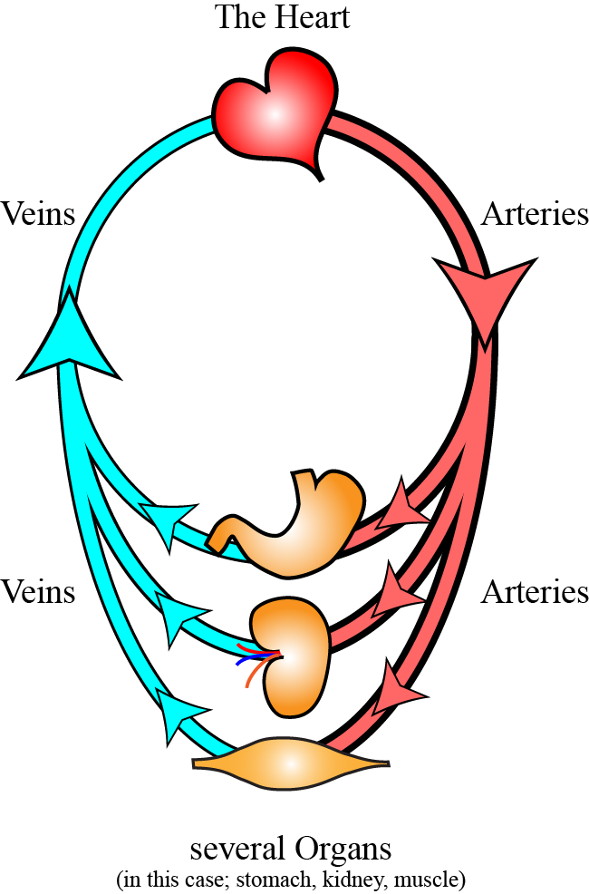
B.1. Introduction to the Cardiovascular System (= CVS)
A. Function of the CVS:
1. The purpose of the cardiovascular system (=CVS) is for the blood to flow through all the organs and tissues of the body.
2. This blood flow is necessary to provide all the organs and tissues with oxygen and nutrients and to remove waste products from them.
www.BasicPhysiology.org B.1. Introduction to the CVS slide #1

Slide 2
A. Function of the CVS:
3. The CVS consists of the following major parts:
    the heart (= cardio
    and the vessels (= vascular):
    b. the arteries
    c. the capillaries
    d. the veins
4. The heart is the pump that pushes the blood through the body. The heart does this by contracting regularly at about 70 beats/min. With every contraction, the heart ‘pushes’ or pumps the blood into the arteries.
www.BasicPhysiology.org B.1. Introduction to the CVS slide #2

Slide 3
A. Function of the CVS:
5. The arteries run from the heart to all the organs. These are really tubes that transports the blood to these organs and tissues. In other words, the blood flows though the arteries from the heart to the organs.
6. The capillaries are located in all the organs and receive the blood from the arteries. Inside the capillaries, the blood exchanges the oxygen and nutrients with the fluid inside the organs and collects all the waste from these organs.
7. The veins collect the blood from the capillaries in the organs and transport it back to the heart.
www.BasicPhysiology.org B.1. Introduction to the CVS slide #3

Slide 4
A. Function of the CVS:
8. In other words, the CVS system is one big circle with the heart (= the pump) at one end of the circle, and the organs (the receiving part), at the other side of the circle.
www.BasicPhysiology.org B.1. Introduction to the CVS slide #4

Slide 5
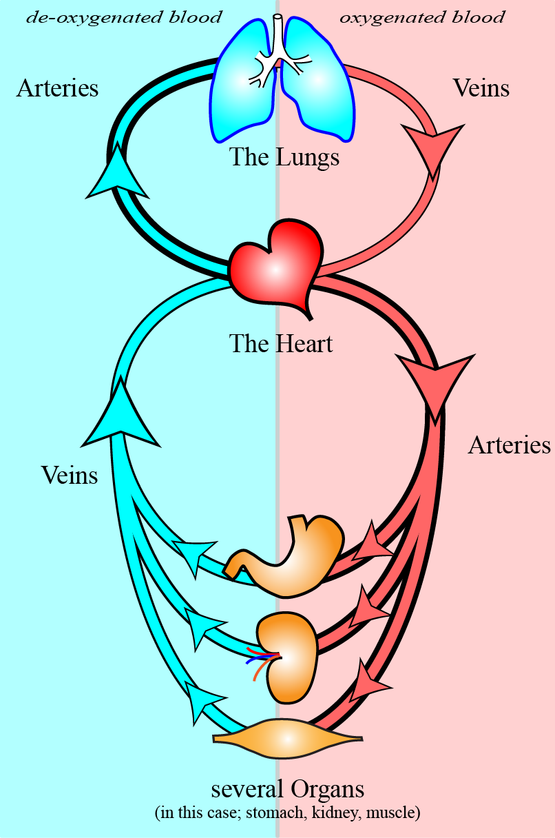
B. The systemic and the pulmonary circulation:
1. However, there are actually, two circulations in the body; the large (also called ‘systemic’) circulation and a smaller circulation.
2. The smaller circulation transports the blood to the lungs (= pulmones). This is why this circulation is called ‘the pulmonary circulation’.
3. The function of the pulmonary circulation is to transport de-oxygenated blood to the lungs where it is re-oxygenated (‘filled with oxygen’).
www.BasicPhysiology.org B.1. Introduction to the CVS slide #5

Slide 6
B. The systemic and the pulmonary circulation:
4. This oxygen rich blood flows back to the heart where it is then pumped into the systemic circulation.
5. In other words, there are actually two hearts; one heart that pumps the oxygenated blood into the systemic circulation and a second heart that pumps de-oxygenated blood to the lungs.
6. Note that the blood vessels coming from the heart to the organs are called ‘arteries’ and the vessels that go from the organs back to the heart are called ‘veins’!
This is crucial stuff!
www.BasicPhysiology.org B.1. Introduction to the CVS slide #6

Slide 7
B. The systemic and the pulmonary circulation:
7. In the systemic circulation, the arteries transport oxygenated blood and the veins transport de-oxygenated blood back to the heart.
8. In the pulmonary circulation, it is the other way around: the pulmonary arteries transport de-oxygenated blood to the lungs and the pulmonary veins transport oxygenated blood back to the heart.
www.BasicPhysiology.org B.1. Introduction to the CVS slide #7

Slide 8
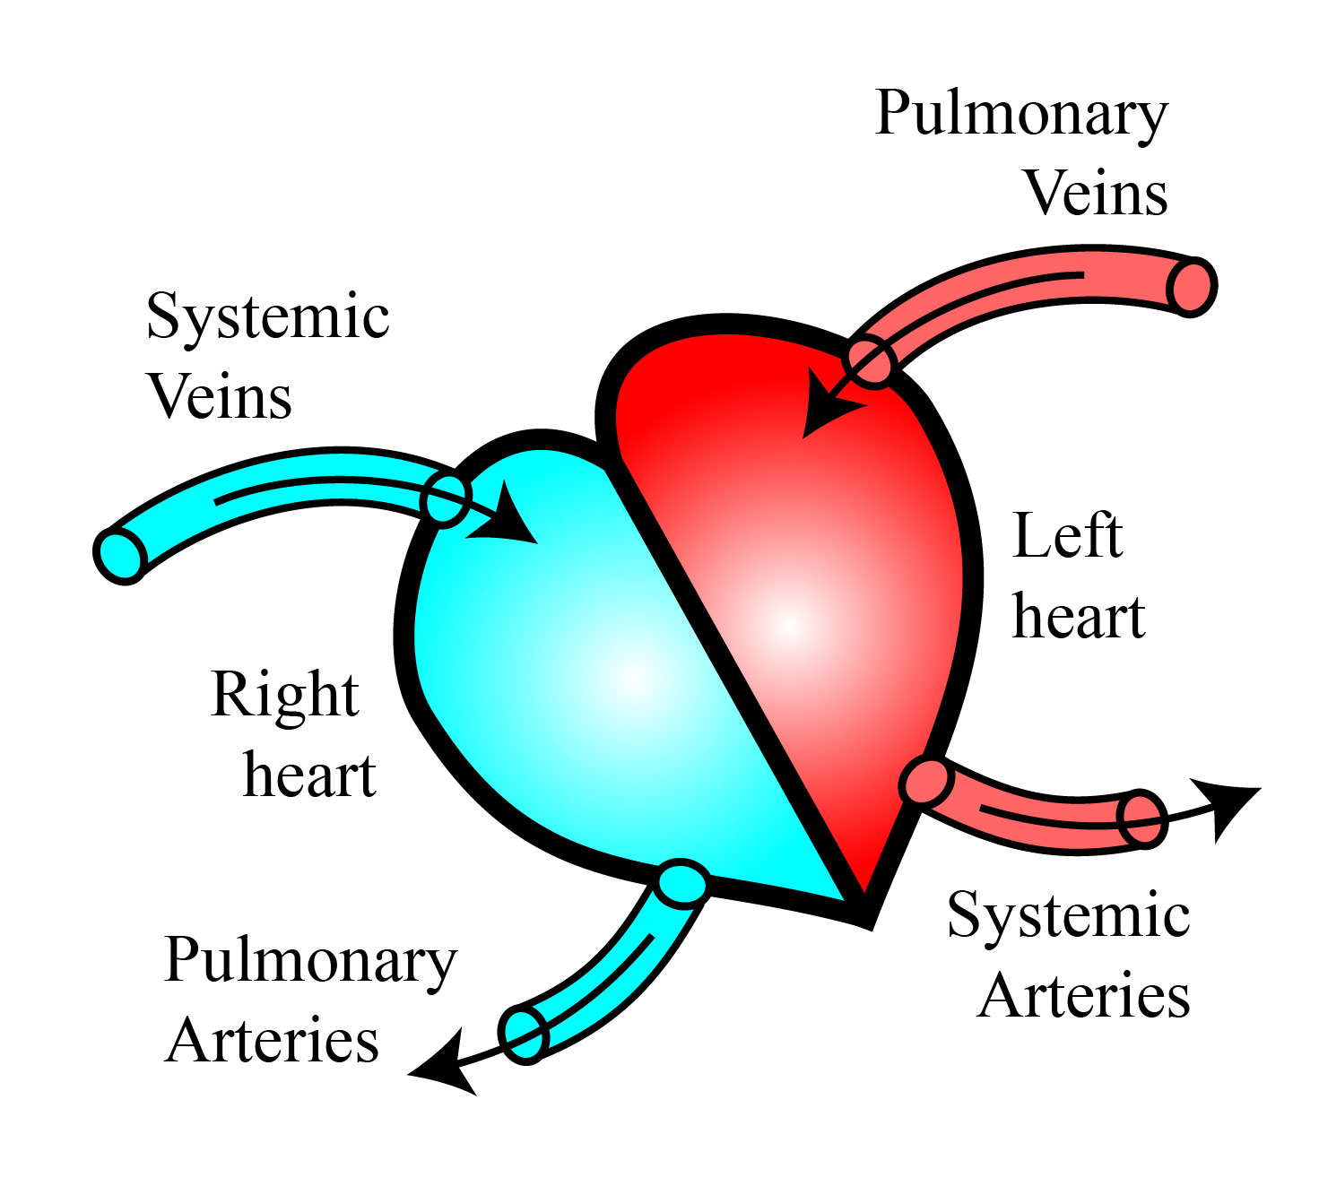
C. The Right and the Left Heart:
1. So, as you have seen above, there are actually two hearts, the right and the left heart.
2. The right heart collects the blood from the veins of the systemic circulation and pumps it to the lungs.
3. The left heart receives the oxygenated blood from the pulmonary veins and pumps it to the arteries of the systemic circulation.
4. When the heart contracts (=pumps), this phase is called the systole. After each contraction (=systole), the heart then relaxes. This is called the diastole.
www.BasicPhysiology.org B.1. Introduction to the CVS slide #8

Slide 9
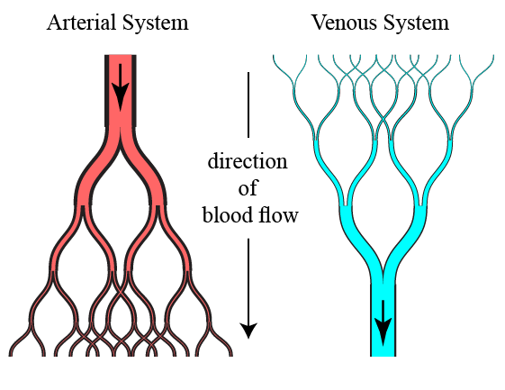
D. The Arterial and the Venous ‘trees’ :
1. Both the arterial and the venous vessels are built like a ‘tree’.
2. This tree starts as a ‘trunk’; which is a major artery or vein. This vessel then splits into smaller and small branches thereby developing into a tree.
3. The major difference between the arterial and the venous tree is that the arterial system splits up into smaller and smaller arteries while in the venous system, the reverse occurs. That is, smaller veins merge gradually into bigger ones.
www.BasicPhysiology.org B.1. Introduction to the CVS slide #9

Slide 10
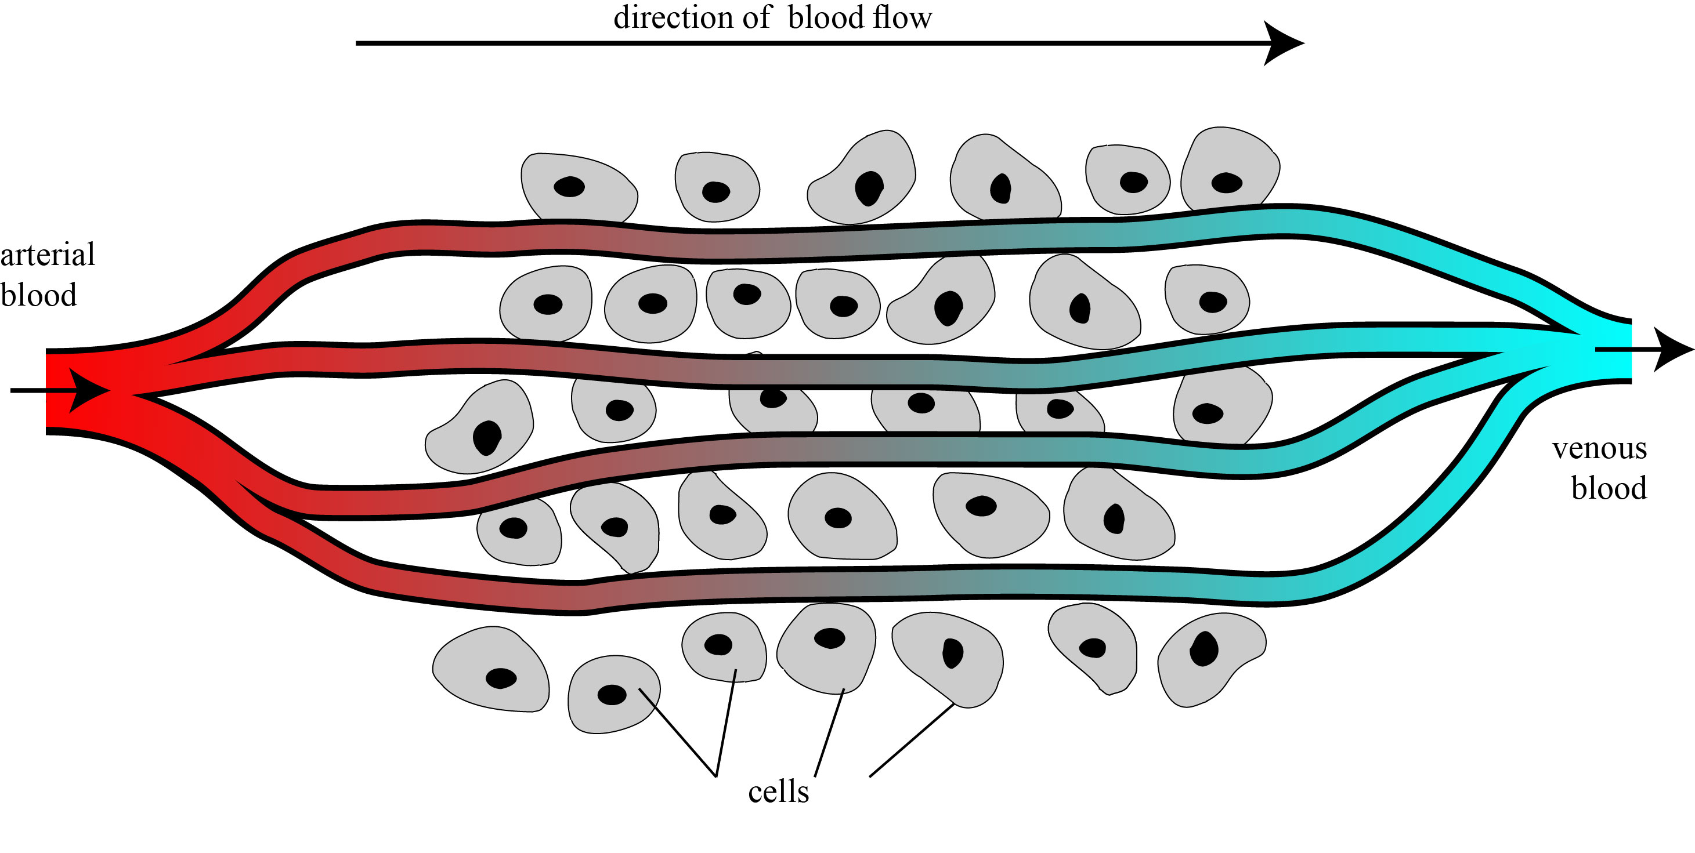
E. The Capillaries:
1. Finally, (!), the capillaries. These are vessels that are very small and very thin.
2. These vessels are so thin that fluid can easily leave the vessel and flow into the organ that they supply.
3. Because fluid, actually water, can easily flow into the tissue of an organ, it also carries the oxygen and other nutrients, which are dissolved in the water, into the organ.
4. At the same time, water can also flow back into the capillaries. This flow allows it to transport waste to the capillaries and back to the veins and, ultimately, to the heart.
www.BasicPhysiology.org B.1. Introduction to the CVS slide #10

