Slide 1
B.3.2. Cardiac Excitation
Purpose:
The heart has to be activated (=excited), through its conduction system, in a specific sequence so that it will contract (i.e. pump) in an orderly manner.
www.BasicPhysiology.org B.3.2. Cardiac Excitation slide #1

Slide 2
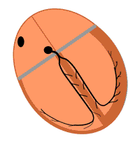
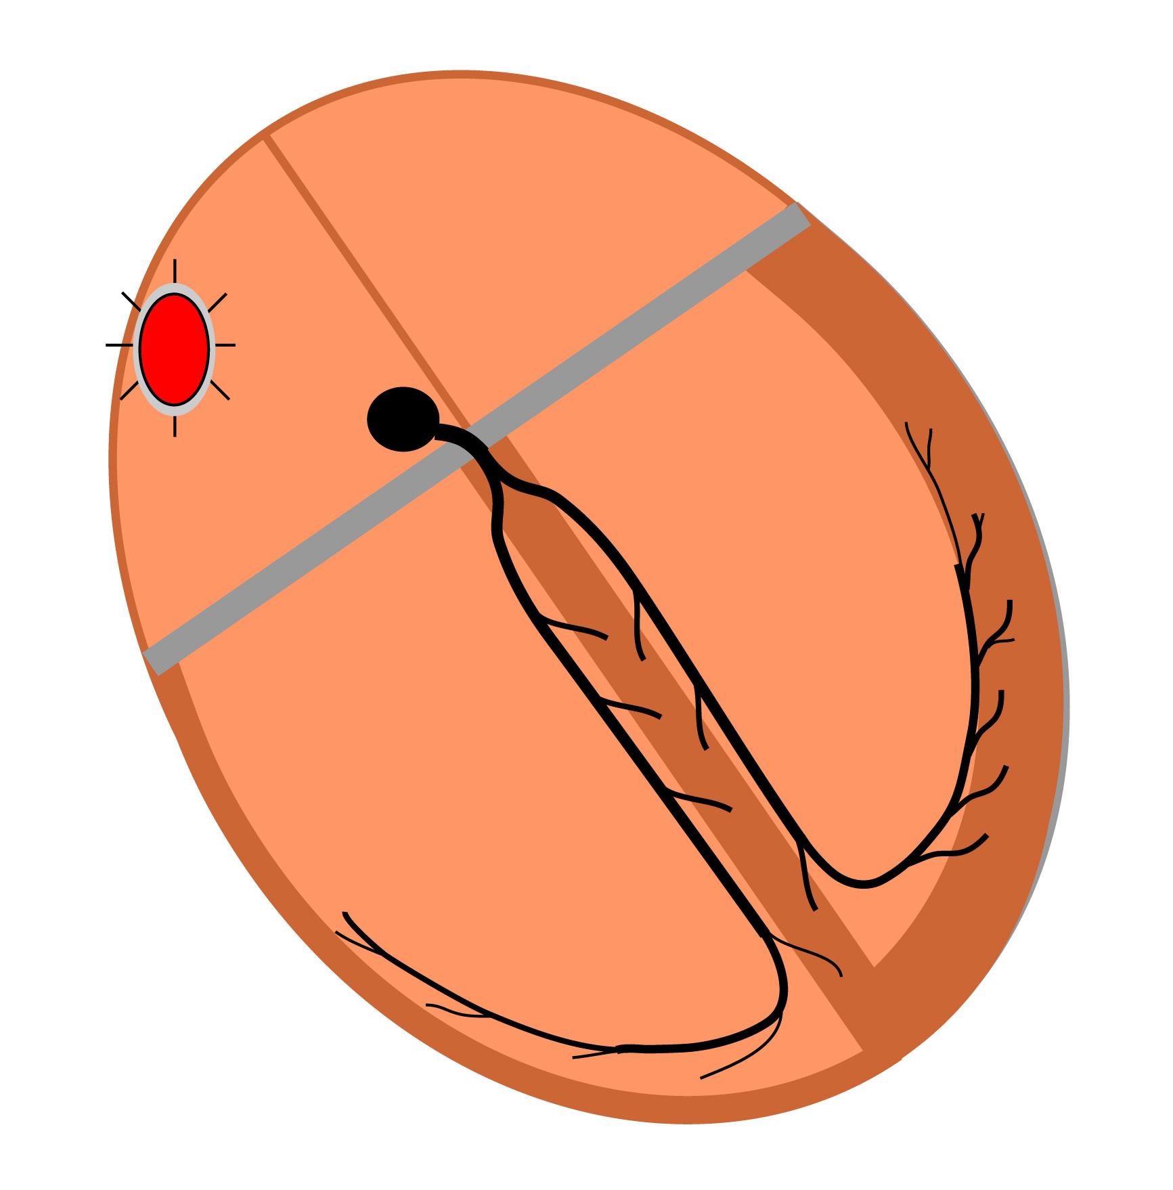
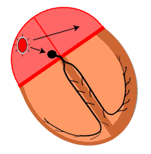
How does the Conducting System excite the heart?
Diastole:
During this phase of the cardiac cycle, the heart is at rest. There are no impulses propagating anywhere in the heart. The heart is electrically ‘silent’.
1. Sinus Node:
The impulse (= action potential) starts in the sinus node. This is normally always the case and that is why the sinus node is called the pacemaker of the heart.
2. Atria:
From the sinus node, the impulse propagates into the atria; first in the right atrium and, a little later, into the left atrium.
www.BasicPhysiology.org B.3.2. Cardiac Excitation slide #2

Slide 3
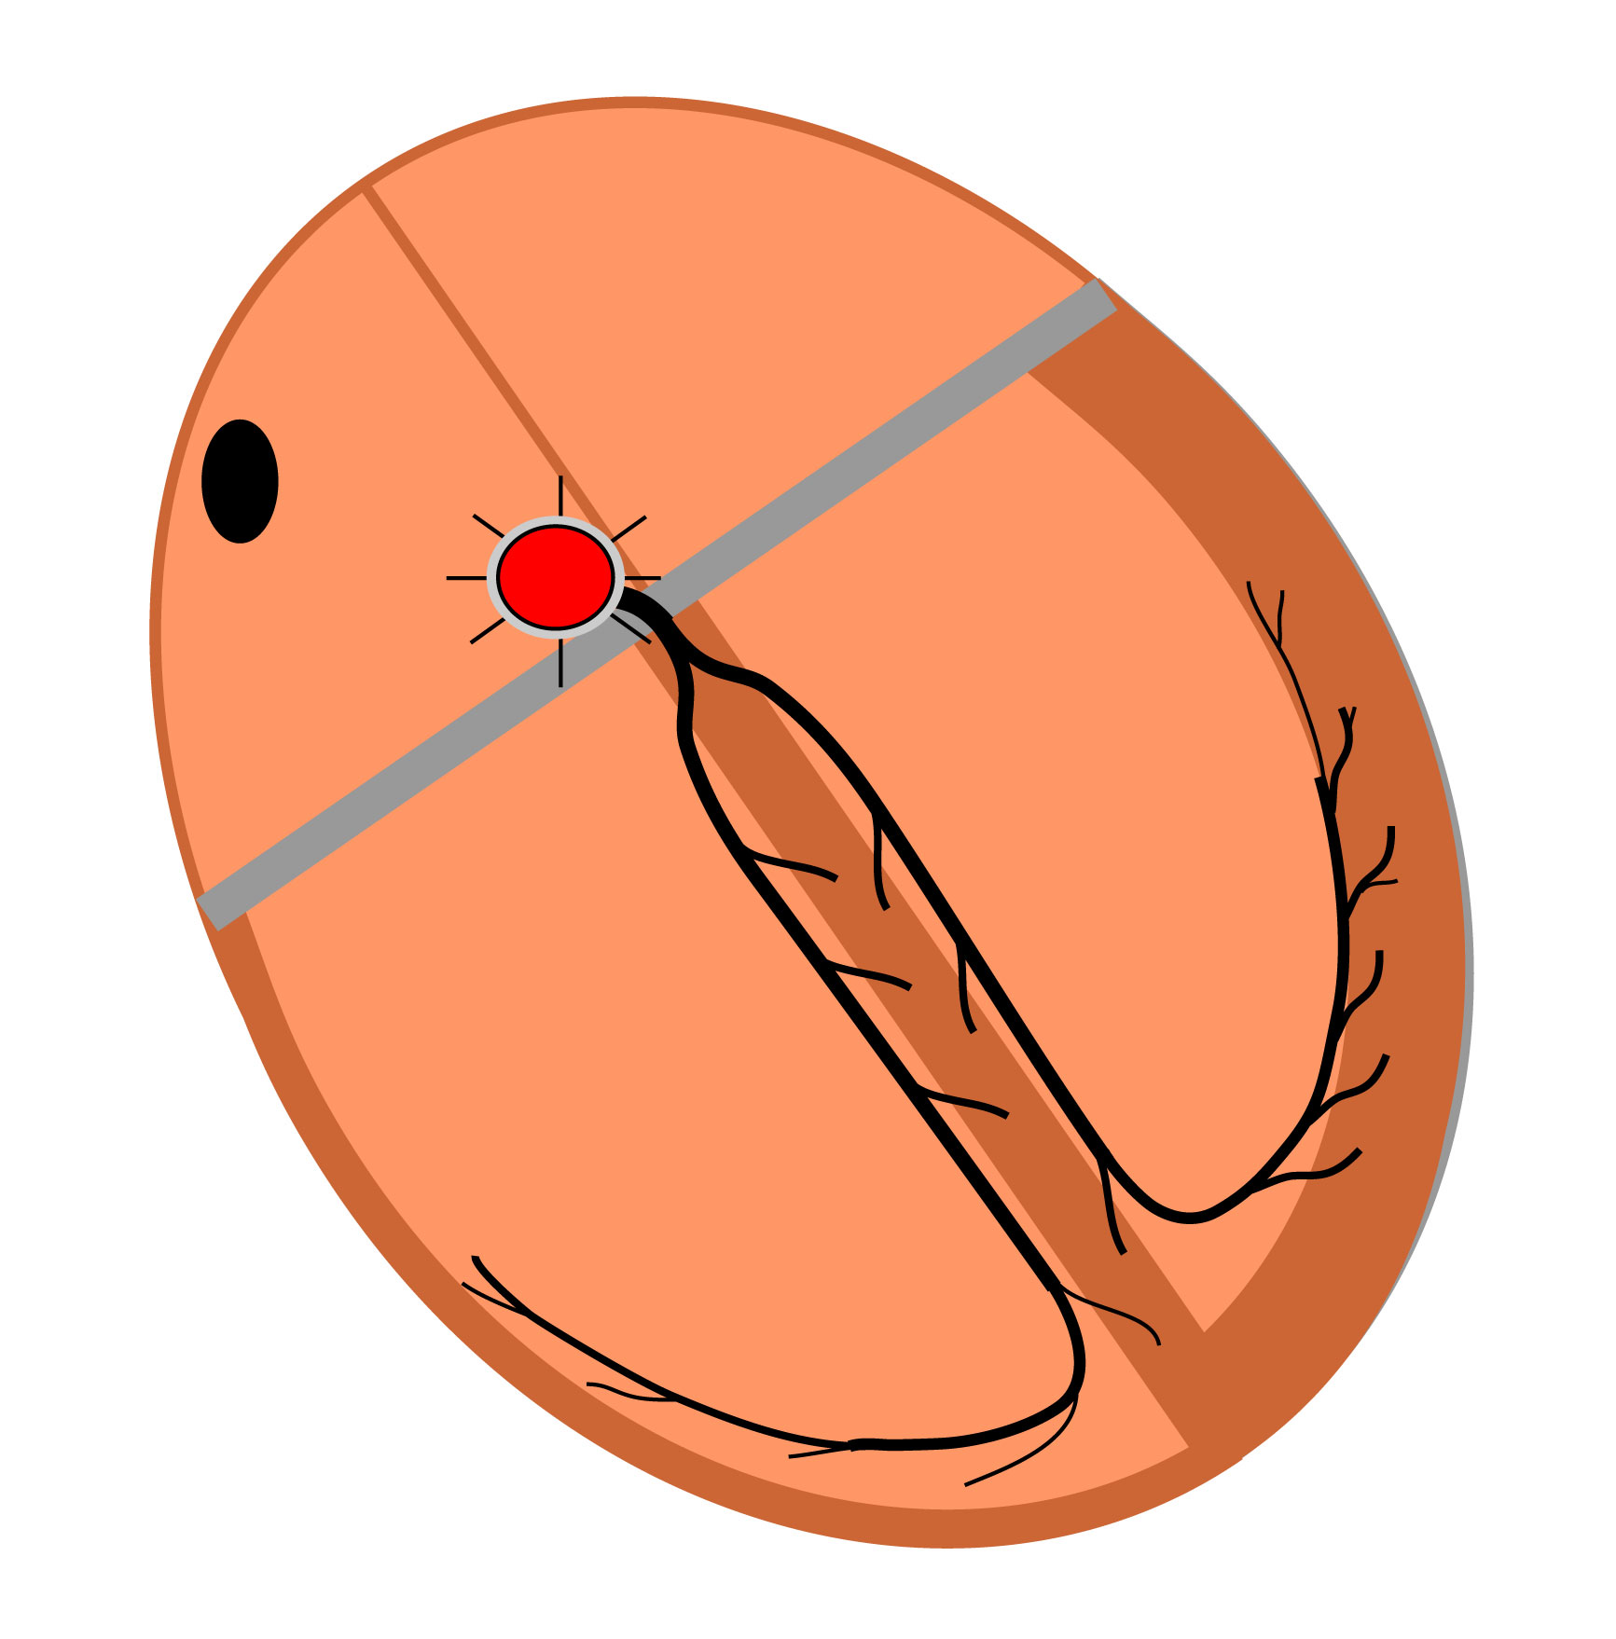
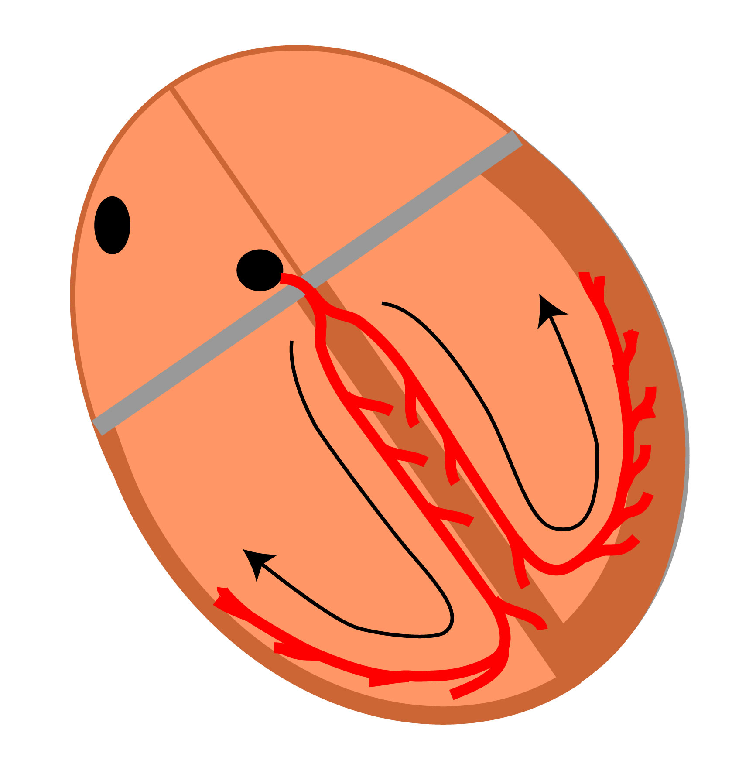
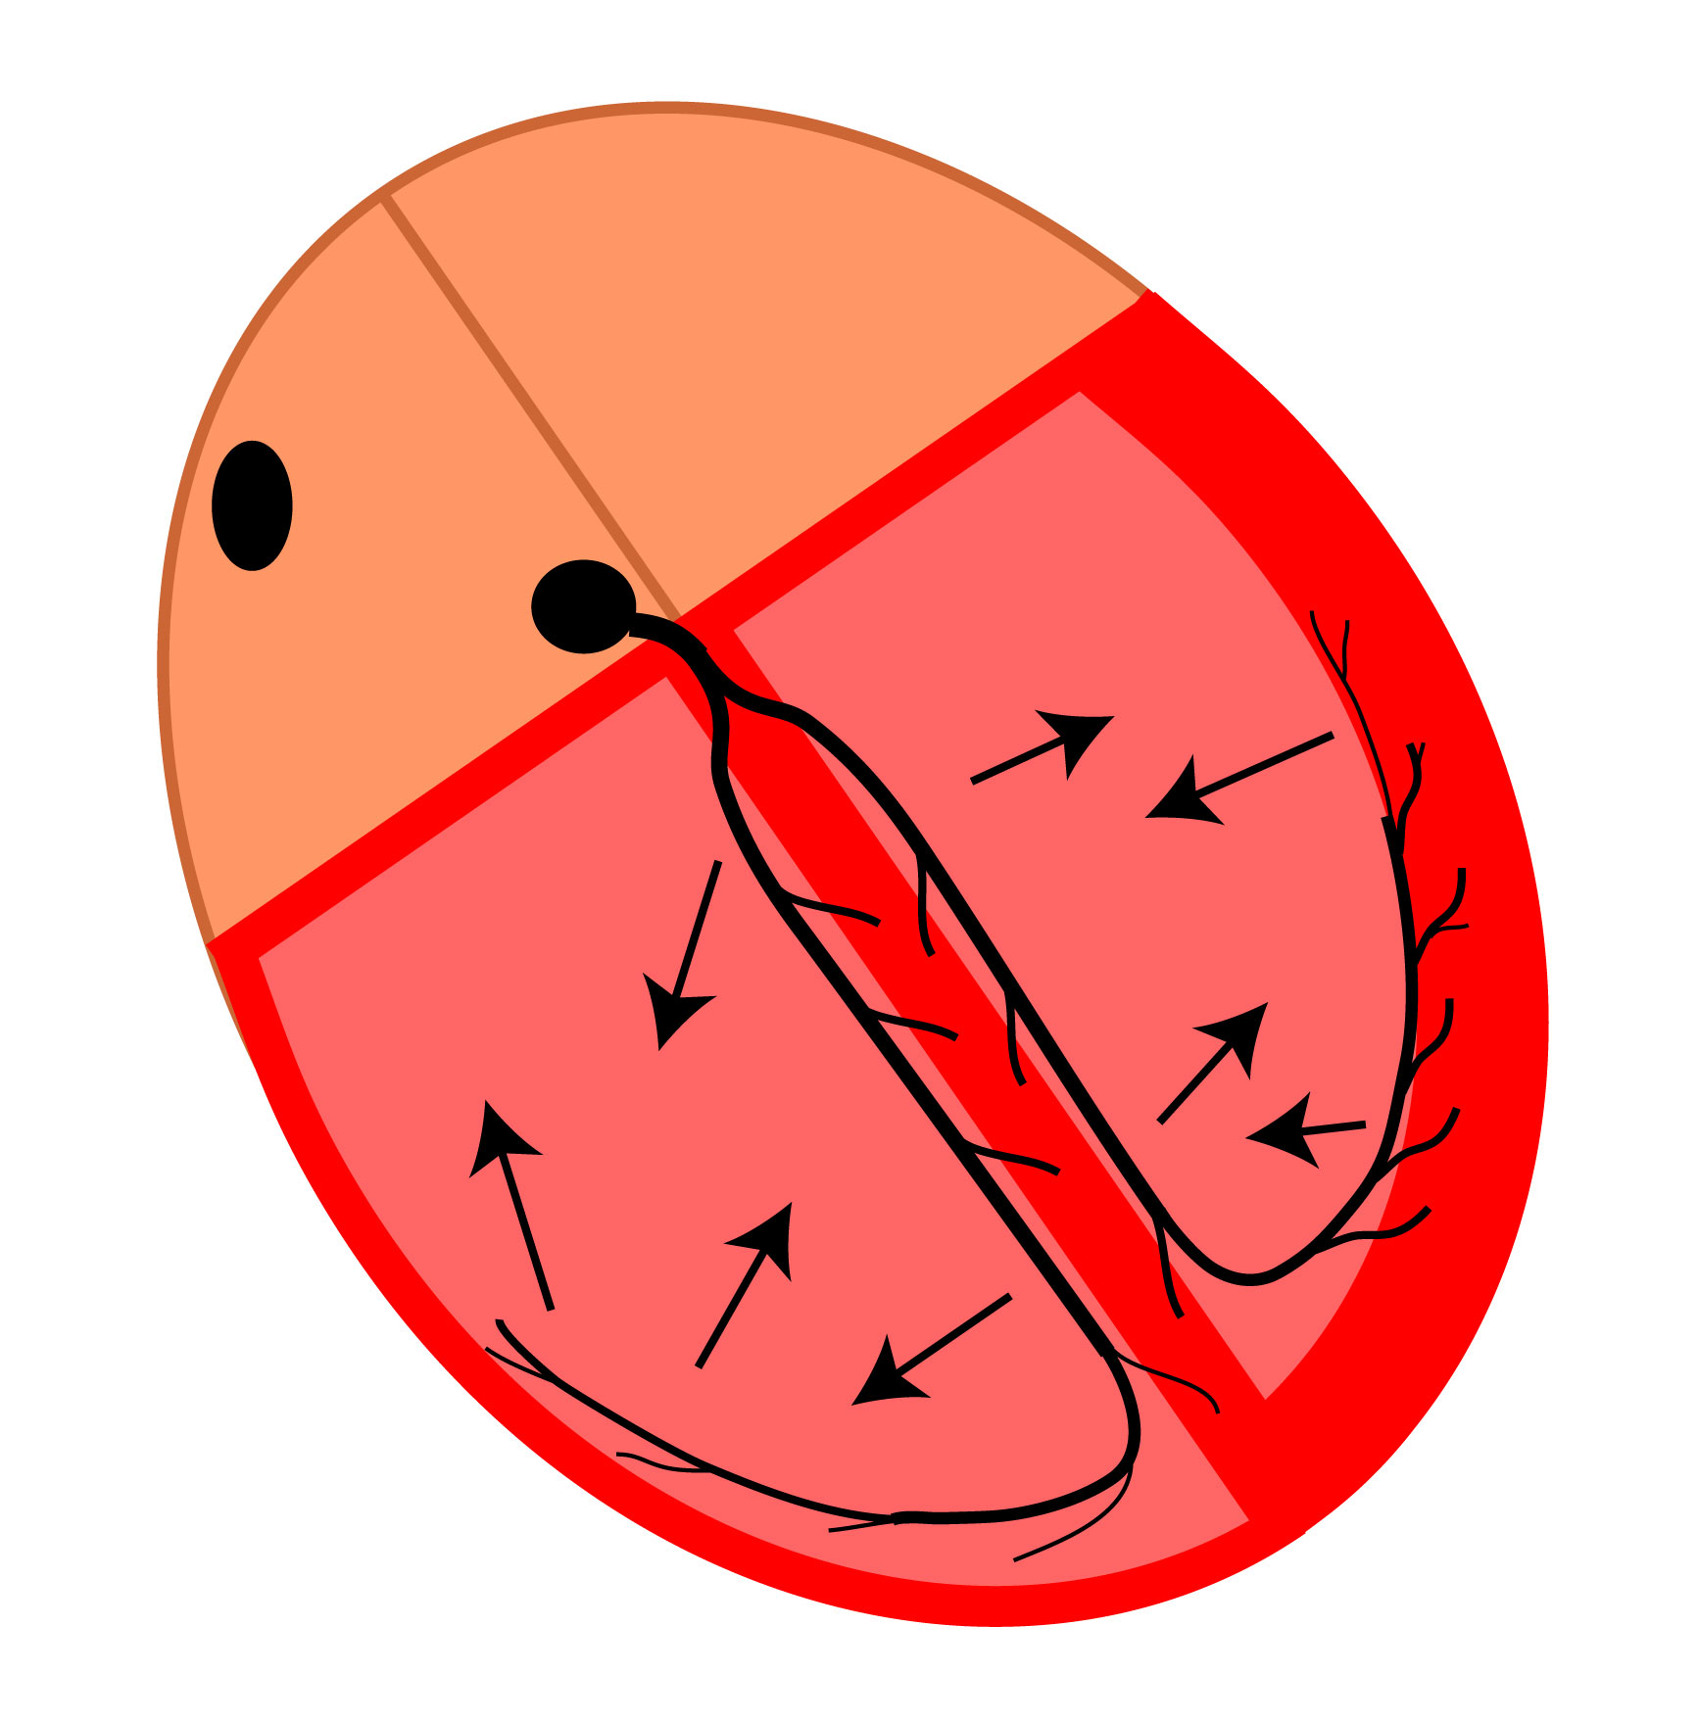
How does the Conducting System excite the heart?
3. The AV-node:
At the bottom of the right atrium, the impulse propagates into the AV-node (the nodal tissue located between the atria and the ventricles).
This is an important step, because the propagation of the action potential in the AV-node is very slow.
4. The Purkinje system:
As the impulse, after a long delay, propagates out of the AV-node, it propagates into the bundle of His and then through the two bundle branches (right and left). This propagation is, in contrast to the propagation in the AV-node, very fast.
5. Ventricles:
Finally, the impulse arrives in the ventricular cells, the ventricular myocytes (cardiac muscle cells), also called the ventricular myocardium.
www.BasicPhysiology.org B.3.2. Cardiac Excitation slide #3

Slide 4
B. Important Notes:
B1. The pacemaker:
1. The SA-Pacemaker:
The pacemaker is normally located in the sinus node. We call this therefore the sinus pacemaker (or the SinoAtrial-pacemaker). The rhythm induced by this pacemaker is called the sinus rhythm.
2. Most rapid rhythm:
The pacemaker is normally located in the sinus node because these cells create new action potentials and they do that faster than other potential pacemakers in the heart.
3. Abnormal pacemaker site:
If the sinus node cells did not make action potentials (because of a disease), then the other nodal cells, in the AV-node, would make action potentials. In that case, there would be an AV-nodal pacemaker.
www.BasicPhysiology.org B.3.2. Cardiac Excitation slide #4

Slide 5
B. Important Notes:
B2. The AV-node:
1. The role of the AV-node:
The major function of the AV-node is to delay the propagation of the impulse from the atria to the ventricles.
2. AV-nodal delay:
This AV-nodal delay is important to make sure that the ventricles contract later and well after the atrial contraction
3. Blood flow:
This delay allows the blood to flow from the contracting atria into the ventricles. If there were no delay, then the ventricles would contract too early and before there was enough blood in the ventricles.
www.BasicPhysiology.org B.3.2. Cardiac Excitation slide #5

Slide 6
B. Important Notes:
B3. The Purkinje System:
1. The role of the Purkinje system:
In contrast to the propagation of the impulse through the AV-node (which is very slow), the propagation through the Purkinje system is very fast!
2. Synchronization:
This is necessary so that the different parts of the ventricles, which are big, are excited as quickly as possible (=synchronized) and will therefore contract more or less simultaneously.
3. No synchronization:
If there were no Purkinje system (or if one branch is blocked), then there would be slow or little propagation in the ventricles. This would lead to some parts contracting early while other parts would contract much later; this would result in poor pumping of the heart.
www.BasicPhysiology.org B.3.2. Cardiac Excitation slide #6

