Slide 1
B.4.1. The Contracting Heart
Purpose:
The heart contracts to pump blood into the arteries. Simple!
www.BasicPhysiology.org B.4.1. The Contracting Heart slide #1

Slide 2
B.4.1. The Contracting Heart
A. Diastole and Systole:
1. When the heart contracts, this is called the “systole” (old Greek for “squeeze”). This is the heartbeat.
2. In the period between the systoles, the heart relaxes and this is called the “diastole” (from a Greek word that means “dilate”).
3. The cardiac systole really consists of two parts:
      The atrial systole
      The ventricular systole
www.BasicPhysiology.org B.4.1. The Contracting Heart slide #2

Slide 3
B.4.1. The Contracting Heart
A. Diastole and Systole:
4. The atrial systole is the first to occur, as the atria are the first to be excited by the sinus node (which is located in the right atrium).
5. Soon after the atrial systole, as the impulse propagates through the AV-node into the Purkinje system, the ventricles are excited and this is the beginning of the ventricular systole (= contraction).
6. After the atrial and the ventricular systole, the cardiac muscle relaxes, dilates (= diastole) which allows blood from the body to flow into the heart, in preparation for the next systole. This period of relaxation is the diastole.
www.BasicPhysiology.org B.4.1. The Contracting Heart slide #3

Slide 4
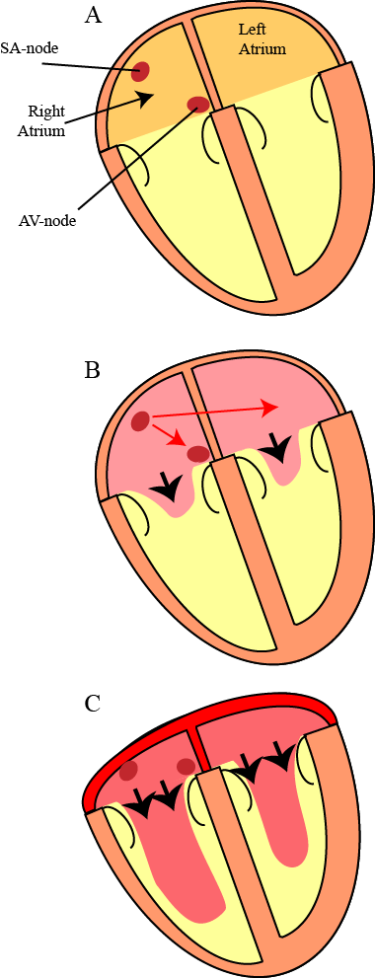
B.4.1. The Contracting Heart
B. Atrial Systole:
1. As in every cardiac cell, the excitation is followed by its contraction. So, the cells that are first activated will be the first to contract.
2. Although the sinus node is the first to be excited (i.e. the pacemaker), it is very small and thus hardly contracts. Therefore, this node does not play a significant role in the contraction of the atrium.
3. The important structures that contract are the right and the left atria.
www.BasicPhysiology.org B.4.1. The Contracting Heart slide #4

Slide 5
B.4.1. The Contracting Heart
B. Atrial Systole:
4. This is useful, as this will push the blood that has accumulated in the atria (from the veins) into the ventricles.
5. Note that the impulse starts in the upper right atrium (close to the sinus node) and propagates towards the AV-ring (=annulus fibrosus).
6. Therefore, the contraction will follow this pattern and start contracting in the right atrium (diagram B). This will push the blood towards the AV-valves and into the ventricles.
www.BasicPhysiology.org B.4.1. The Contracting Heart slide #5

Slide 6
B.4.1. The Contracting Heart
B. Atrial Systole:
7. Also note that both atria contract nearly simultaneously. The right atria will contract a little bit earlier than the left atrium (because the sinus node is located in the right atrium) but this difference is very small and negligible.
8. As the atria contracts, the blood pressure increases in the atria and blood is pushed from the atria into the ventricles.
www.BasicPhysiology.org B.4.1. The Contracting Heart slide #6

Slide 7
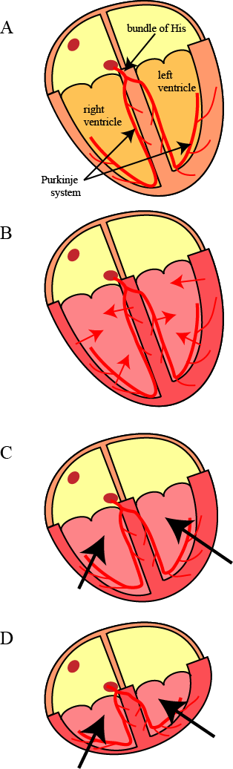
B.4.1. The Contracting Heart
C. Ventricular Systole:
1. The ventricular contraction starts as the impulse arrives at the ventricular myocardial cells.
2. As in the atrial nodal cells, the bundle of His and the Purkinje cells are too small to help in the contraction (their function is only to distribute as quickly as possible the action potential throughout the ventricles).
3. It is only when the ventricular myocardium is finally excited that the ventricular systole has started.
www.BasicPhysiology.org B.4.1. The Contracting Heart slide #7

Slide 8
B.4.1. The Contracting Heart
C. Ventricular Systole:
4. Again, as both the right and the left ventricle are activated, through the right and the left bundle branches, more or less simultaneously, both ventricles will also contract at the same time.
5. As both ventricles contract, their length will decrease towards the fibrotic ring and the valves.
6. With the decrease in length and size, the volume inside the ventricles will also decrease. This will push (= pump) the blood out of the ventricles into the major arteries (see next presentation: The haemodynamic heart).
www.BasicPhysiology.org B.4.1. The Contracting Heart slide #8

