Slide 1
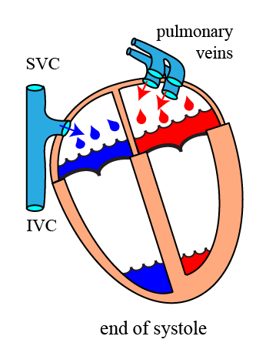
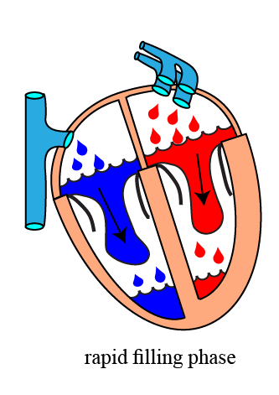
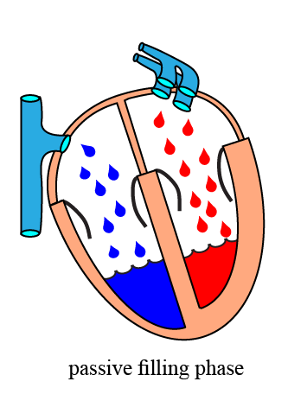
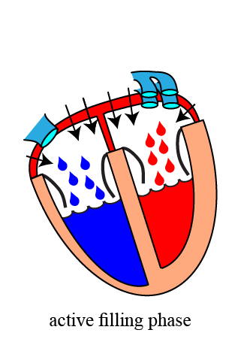
B.4.3. The Cardiac Diastole
A. Blood flow during the diastole:
1. The diastole is the period during which the ventricles relax and gets filled again with blood for the next systole.
2. As with the systole, we can divide this period into three phases:
the rapid filling phase
the passive filling phase
the active filling phase
www.BasicPhysiology.org B.4.3. The Cardiac Diastole slide #1

Slide 2
B.4.3. The Cardiac Diastole
A. Blood flow during the diastole:
3. Remember that during the systole, the AV-valves are closed. Blood that has meanwhile flown from the veins (VCS = vena cava superior, VCI = vena cava inferior and from the pulmonary veins) into the atria have accumulated in that space.
4. At the beginning of the diastole, when the AV-valves open, this accumulated blood will suddenly and rapidly flow into the ventricles; this the rapid filling phase.
www.BasicPhysiology.org B.4.3. The Cardiac Diastole slide #2

Slide 3
B.4.3. The Cardiac Diastole
A. Blood flow during the diastole:
5. Once this accumulated blood has flown into the ventricles, blood keeps streaming in from the veins into the atria. This blood can immediately flow further into the ventricles: passive filling phase.
6. At the end of the ventricular diastole, the sinus node will become excited again and the atrial systole will start (remember that the atrial systole starts before the ventricular systole). This atrial excitation will induce atrial contraction and this will squeeze the last remaining blood into the ventricles; active filling phase.
www.BasicPhysiology.org B.4.3. The Cardiac Diastole slide #3

Slide 4
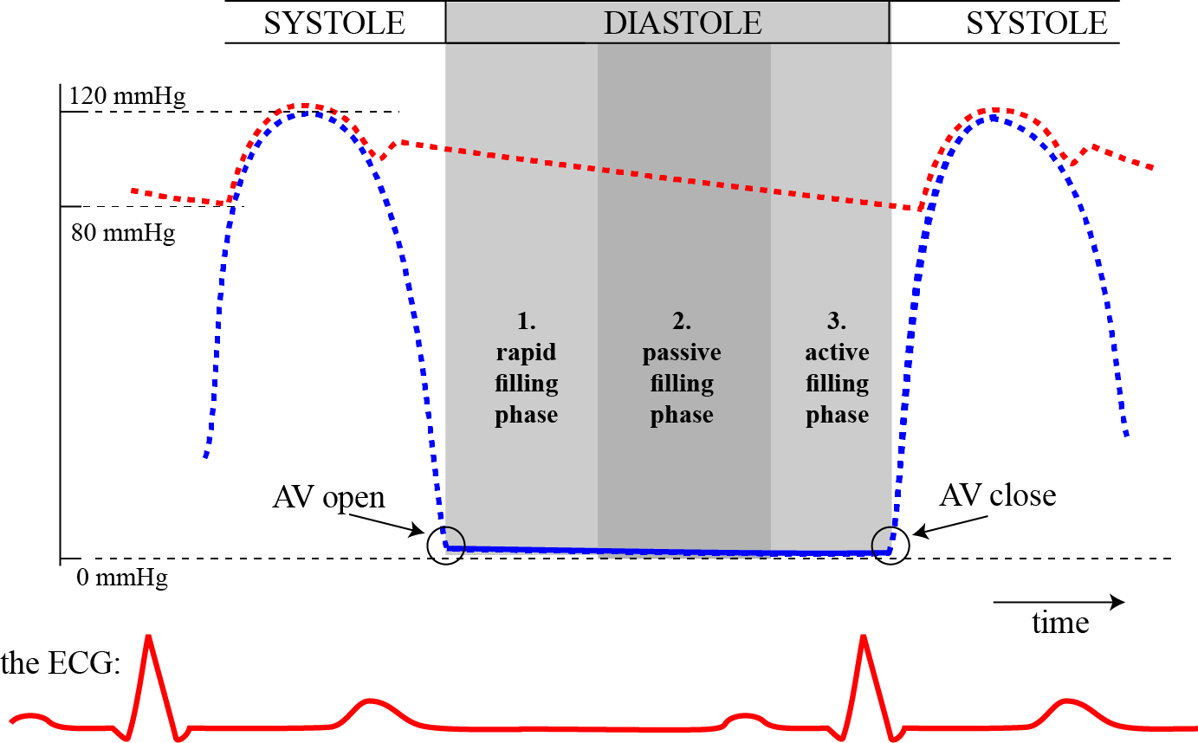
B.4.3. The Cardiac Diastole
B. Blood pressure during the diastole:
1. As I said before, the diastole begins when the AV-valves open and ends when the AV-valves close (at the next systole).
2. During diastole, the pressure in the ventricles is very low, close to zero mmHg. This is important as it must be lower than the low pressures in the atria, or else, blood would not flow into the ventricles.
3. Therefore, as shown in the diagram, there is not much change in the ventricular pressure during diastole, in contrast to the big change during systole.
www.BasicPhysiology.org B.4.3. The Cardiac Diastole slide #4

Slide 5
B.4.3. The Cardiac Diastole
C. Additional notes:
1. Note that the blood flow from the veins into the atria is constant and continuous and is never interrupted during systole and diastole.
2. But, because of the pumping of the heart, the blood that flows out of the heart, into the arteries is not continuous but pulsatile (in “spurts”).
3. While the ventricles contract, the AV-valves are closed but there must be space available where meanwhile the venous blood can be collected or “pooled”.
www.BasicPhysiology.org B.4.3. The Cardiac Diastole slide #5

Slide 6
B.4.3. The Cardiac Diastole
C. Additional notes:
4. This pooling of blood is done in the atria. This is the major function of the atria.
5. Note that the atrial contraction only plays a minor role in the blood flow from the atria into the ventricles; estimated at about 25% of the total blood flow.
6. But, if the ventricles don’t contract, then of course there will be NO blood flow into the arteries at all! This is simply incompatible with life.
www.BasicPhysiology.org B.4.3. The Cardiac Diastole slide #6

