Slide 1
B.5.7. Blood Flow
1. What is blood flow?
This is the amount of blood flowing through an organ or an organ system, expressed as ml or l (=litres) per minute.
If you take the whole systemic circulation, then the blood flow is the same as the cardiac output: 5 L/min.
2. Blood flows from an area with a high pressure to an area with a lower pressure.
If there were no difference in pressures, then there would be NO blood flow.
www.BasicPhysiology.org B.5.7. Blood Flow slide #1

Slide 2
B.5.7. Blood Flow
3. Pressure gradient.
The difference in pressure is called the pressure gradient. The higher the pressure gradient, the higher the blood flow.
4. Resistance.
But there is also a resistance to the flow of blood in the vessels. The higher the resistance, the lower the blood flow.
5. There are three important components to the resistance:
    Blood viscosity
    Vessel length
    Vessel diameter
www.BasicPhysiology.org B.5.7. Blood Flow slide #2

Slide 3
B.5.7. Blood Flow
6. Blood Viscosity:
This is the thickness or the "stickiness" or the "sluggishness" of the blood. Blood is much more viscous than water because it contains many cells, proteins etc.
7. Vessel Length:
This is easy to understand: the longer the vessel, the higher the resistance. Think of the long water hose in the garden. This factor is also important in medicine; for example, fat (=obese) people tend to have longer vessels > more resistance > more difficulties with their hearts
www.BasicPhysiology.org B.5.7. Blood Flow slide #3

Slide 4

B.5.7. Blood Flow
8. Vessel Diameter:
This is also easy to understand; if a vessel is narrower, the resistance will increase. If the vessel is wider, the resistance will be lower. This is very important in physiology and is the basis for regulating the blood flow distribution by vasoconstriction and vasodilatation.
9. Summary:
Blood flow is directly proportional to the difference in pressure and inversely proportional to the resistance. In fact, this can be stated in a formula:
www.BasicPhysiology.org B.5.7. Blood Flow slide #4

Slide 5
B.5.7. Blood Flow
10. Law!
Some of you may know this as a law (Poiseuille's Law). The important thing here is that the flow is related to the fourth power of the radius of the vessel!! This is very strong; a very small change in diameter (vasoconstriction or vasodilatation) will have a strong influence on blood flow!
www.BasicPhysiology.org B.5.7. Blood Flow slide #5

Slide 6
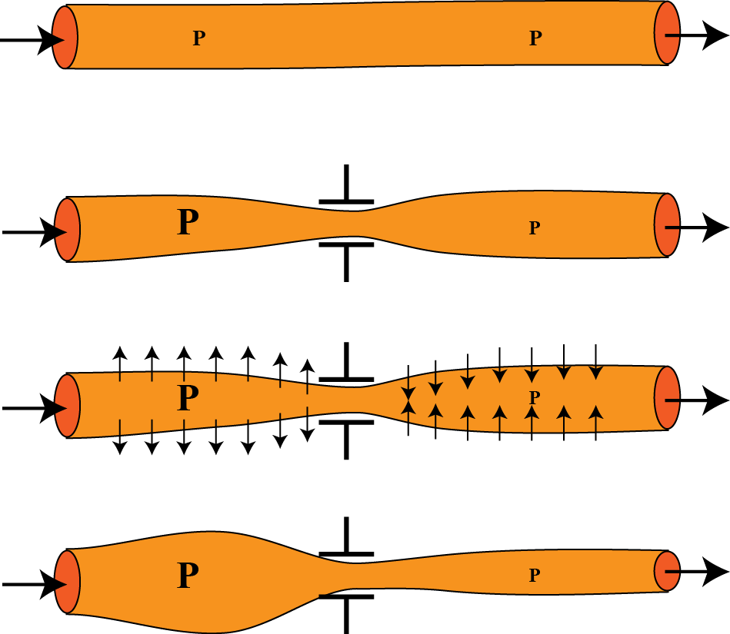
B.5.7. Blood Flow
B. A few words about (local) vasoconstriction:
1. What really happens when there is a local vasoconstriction?
2. This is often a problem for students. They often think that the pressure changes under the constriction and not before or after the constriction.
3. In this drawing, at the top, there is a normal blood vessel with a normal pressure. The blood is flowing from left to right.
www.BasicPhysiology.org B.5.7. Blood Flow slide #6

Slide 7
B.5.7. Blood Flow
B. A few words about (local) vasoconstriction:
4. In the middle of the vessel, we squeeze the blood vessel. Therefore, the diameter at that point will decrease, the resistance increase and the blood flow will therefore decrease.
5. Therefore, blood is accumulating before the constriction (upstream of the narrowing). This accumulation will increase the pressure there!
6. After the constriction, downstream, the flow will decrease and the pressure will therefore also decrease.
www.BasicPhysiology.org B.5.7. Blood Flow slide #7

Slide 8
B.5.7. Blood Flow
B. A few words about (local) vasoconstriction:
7. The pressure increase will expand the blood vessel before the constriction.
8. While, downstream, the blood vessel will become narrower, due to the lower pressure. That’s it!
www.BasicPhysiology.org B.5.7. Blood Flow slide #8

Slide 9
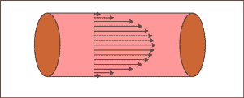
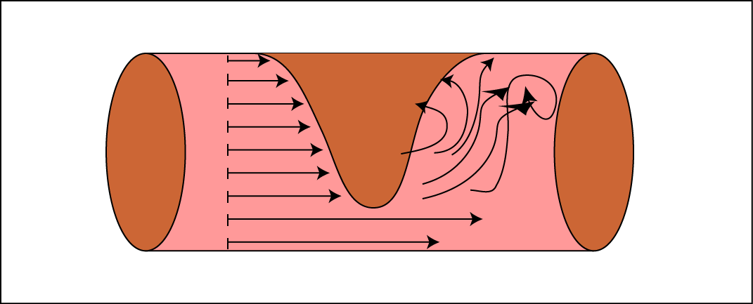
B.5.7. Blood Flow
C. Flow Types (laminar and turbulent flow):
1. Laminar Flow:
In a normal vessel, blood flows straight through the tube. In fact, blood flows faster in the centre and more slowly along the wall of the vessels. This is of course due to the resistance of the blood against the walls of the vessel.
2. You can then imagine a stack of thin layers of blood flowing at different velocities alongside each other; fast in the centre and much slower along the wall. This is called "laminar" flow.
www.BasicPhysiology.org B.5.7. Blood Flow slide #9

Slide 10
B.5.7. Blood Flow
C. Flow Types (laminar and turbulent flow):
3. Turbulent flow:
But sometimes, when the vessel is narrower, or if there is an obstruction, then this laminar flow is disrupted. Blood will flow in different directions, loops and become irregular. This is called "turbulent".
4. Turbulent flow is important in medicine because turbulent flow makes a noise. Therefore, one can hear it with a stethoscope. If you hear such a sound in a patient, you can with this method detect a local obstruction in his or her blood vessels.
www.BasicPhysiology.org B.5.7. Blood Flow slide #10

Slide 11
B.5.7. Blood Flow
D. Local Blood Flow Regulation:
1. Why is local blood flow important?
Every tissue and every organ need blood for its function and for its survival. It needs oxygen and other nutrients and has to get rid of CO2 and other waste products.
2. How much is needed?
It turns out that the amount of blood delivered to a tissue or an organ is pretty well the amount that the tissue requires; not more, not less.
If it needs more, it will get more. If it needs less, it will get less!! But how is this regulated?
www.BasicPhysiology.org B.5.7. Blood Flow slide #11

Slide 12
B.5.7. Blood Flow
D. Local Blood Flow Regulation:
3. Not the nervous system:
It is not possible for the nervous system to regulate this (because this would require an enormous number of nerves to innervate all these arterioles).
4. Local regulators (= autoregulation):
It is the local factors that determine how much blood is needed at a particular moment.
www.BasicPhysiology.org B.5.7. Blood Flow slide #12

Slide 13
B.5.7. Blood Flow
D. Local Blood Flow Regulation:
5. Oxygen:
Local oxygen is probably the most important factor. If there is a shortage of oxygen, then the local arterioles will dilate, thereby increasing blood flow and increase in the oxygen. This is called the "oxygen-demand" theory: the oxygen demands more blood.
6. Other local factors:
But there are many other factors that can also play a role; potassium, hydrogen ions, lactic acid, adenosine, several prostaglandins, and inflammatory signals (histamine)
www.BasicPhysiology.org B.5.7. Blood Flow slide #13

Slide 14
B.5.7. Blood Flow
D. Local Blood Flow Regulation:
7. Active Hyperaemia:
Sometimes, the term "active hyperaemia" (= more blood in the tissue) is used to describe this condition. (i.e. the tissue itself is active to get more blood)
8. Reactive Hyperaemia:
When an organ or a tissue, for some reason, like a temporary obstruction, has not received enough blood for some time, it will, after the obstruction has been removed, receive more blood than usual. The organ therefore "reacts" to a temporary lack of blood.
www.BasicPhysiology.org B.5.7. Blood Flow slide #14

