Slide 1
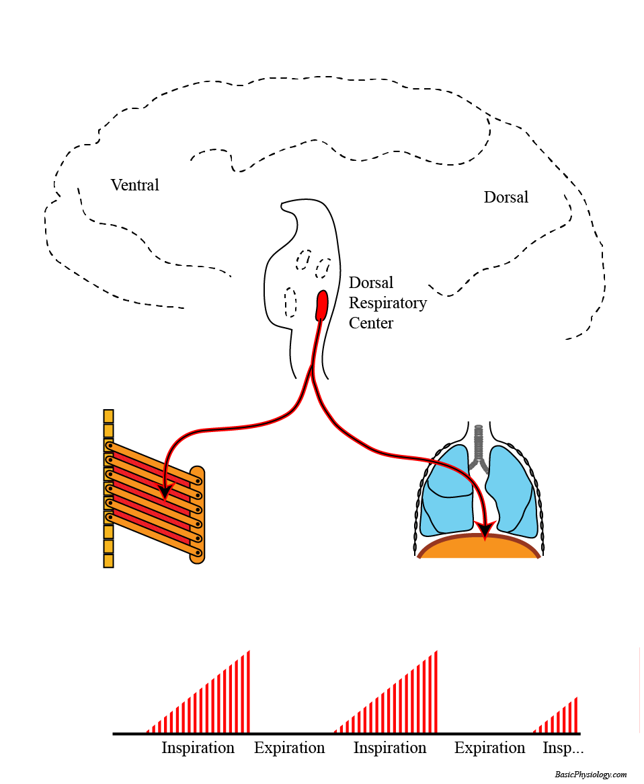
C.6. Respiratory Regulation
A. How is our respiration regulated?
1. In contrast to the heart, the lungs do not have their own pacemaker center.
2. The lungs are inflated and deflated by the action of the rib muscles and the diaphragm. These, in turn, are activated by nerve cells located in the brain. (The muscles are striated skeletal muscles).
3. Specifically in the lower part of the brain (the medulla and the pons), there are several clusters of nerve cells that control our respiration.
www.BasicPhysiology.org C.6. Respiratory Regulation slide #1

Slide 2
C.6. Respiratory Regulation
A. How is our respiration regulated?
4. The most important cluster (or center) is the Dorsal Respiratory Center (because it is located dorsal to another center that is located more ventrally; see later).
5. The nerve cells in the Dorsal Respiratory Center send axons to the external intercostal muscles, located between the ribs, and to the diaphragm.
www.BasicPhysiology.org C.6. Respiratory Regulation slide #2

Slide 3
C.6. Respiratory Regulation
A. How is our respiration regulated?
6. When these cells “fire” (make action potentials), then these action potentials will propagate to the intercostal muscles and to the diaphragm and these will then contract; this is the inspiration phase.
7. When they stop firing, then the ribs and the diaphragm will relax and this is the (passive) expiration phase. Remember; normal expiration is passive; it does not require any action potentials and muscle contractions.
www.BasicPhysiology.org C.6. Respiratory Regulation slide #3

Slide 4
C.6. Respiratory Regulation
B. The Ramp Signal:
1. Notice the shape of the burst of action potentials in the diagram. They start very small (= very few action potentials) but the number of action potentials gradually grows until maximum is reached at the end of the inspiration.
2. This behavior looks like a ‘ramp’; a slow and soft start followed by a progressive increase in activity until maximum is reached. This pattern has a purpose: it is good to start the inspiration slowly.
www.BasicPhysiology.org C.6. Respiratory Regulation slide #4

Slide 5
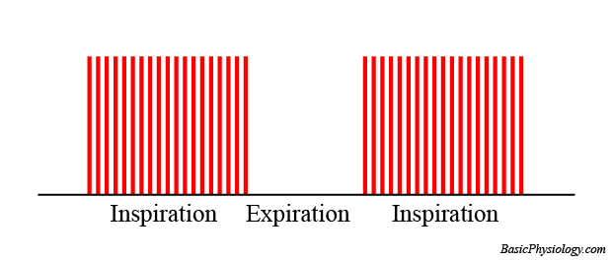
C.6. Respiratory Regulation
B. The Ramp Signal:
3. Suppose that there was no ramp and that all nerve cells started to fire simultaneously, like in the right diagram.
4. If all the neurons had started all together, then inspiration would suddenly start with a loud and strong ‘gasp’; not very nice.
5. So, the slope of the ‘ramp’ is very important as this determines the speed and the strength of how we inspire.
www.BasicPhysiology.org C.6. Respiratory Regulation slide #5

Slide 6
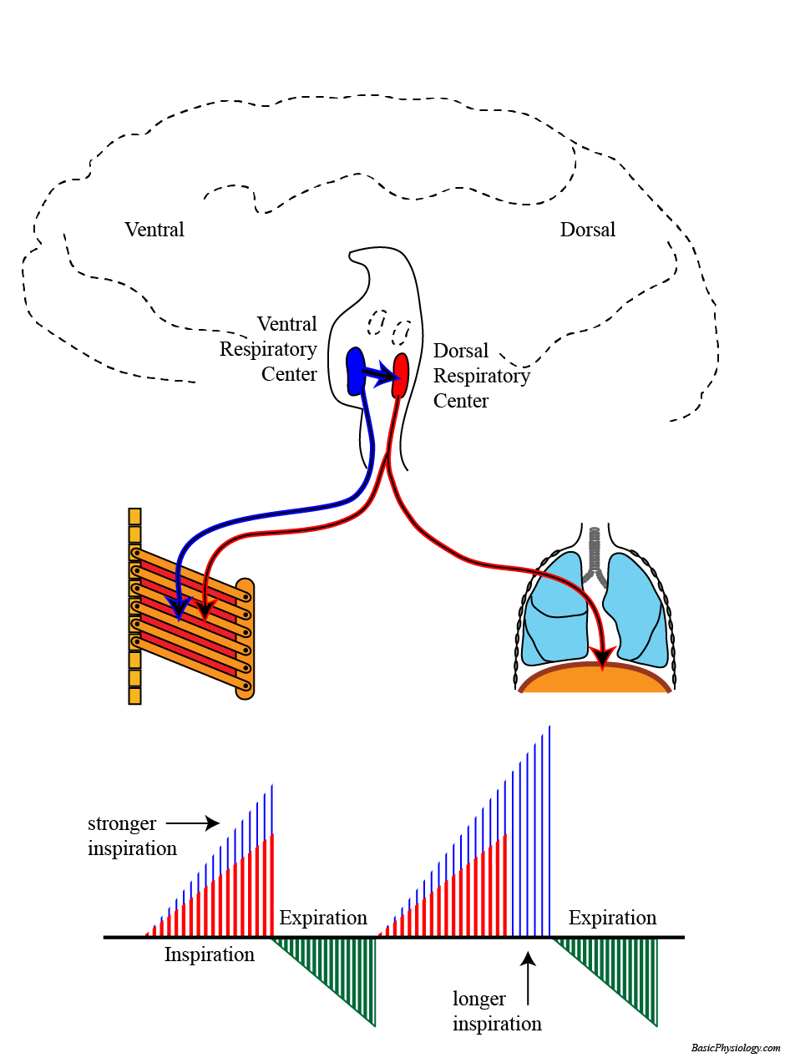
C.6. Respiratory Regulation
C. Stronger Respiration and Expiration:
1. Sometimes, you need to have stronger, deeper and/or a faster respiration. Then other centers will join the Dorsal Respiratory Center to control the respiration.
2. The most important additional center is the Ventral Respiratory Center. This center will join the nerve cells from the Dorsal Center in sending more action potentials.
www.BasicPhysiology.org C.6. Respiratory Regulation slide #6

Slide 7
C.6. Respiratory Regulation
C. Stronger Respiration and Expiration:
3. As shown in this diagram, the Ventral Respiratory Center is located close to the Dorsal Group. It sends nerve fibers to the chest but also directly to the Dorsal Group.
4. With these additional impulses, more muscles will be excited and contract leading to a stronger inspiration.
5. This is also indicated in the ramp signal, in blue, leading to larger amplitudes (deeper breathing) and longer duration (inspiration).
www.BasicPhysiology.org C.6. Respiratory Regulation slide #7

Slide 8
C.6. Respiratory Regulation
C. Stronger Respiration and Expiration:
6. Also, the expiration is now also activated because the ventral group also sends nerve fibers to muscles that will help in the expiration (green ramp).
7. As shown in the diagram, nerves now also excite the external intercostal muscles which help the expiration.
www.BasicPhysiology.org C.6. Respiratory Regulation slide #8

Slide 9
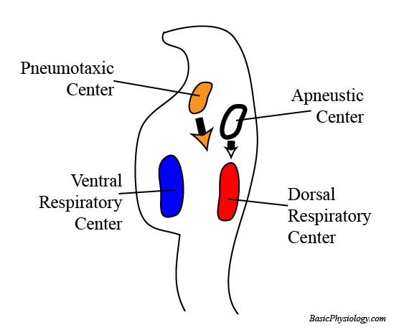
C.6. Respiratory Regulation
D. Two more centers: the pneumotaxic center and the apneustic center!
1. Unfortunately (for the student!), there are two more centers, located above the Dorsal and the Ventral group.
2. These two regulate the behavior of the two lower groups.
3. It is thought that the Pneumotaxic center decreases the duration of the inspiration.
www.BasicPhysiology.org C.6. Respiratory Regulation slide #9

Slide 10
C.6. Respiratory Regulation
D. Two more centers: the pneumotaxic center and the apneustic center!
4. The apneustic center seems to be able to prolong the inspiration.
5. In experiments, it was even possible to keep the lungs in the inflated state, effectively stopping all respiration (hence its name; apneu!).
(apneu = no pneu(matism) = no respiration).
6. In general, both the pneumotaxic and the apneustic center fine-tune the work of the dorsal and the ventral Respiratory Centers.
www.BasicPhysiology.org C.6. Respiratory Regulation slide #10

Slide 11
C.6. Respiratory Regulation
E. Regulation of the Respiratory Centers:
1. The Respiratory centers don’t work on their own but are influenced by excitatory and inhibitory signals from the body.
2. There are about five (!) different type of signals that regulate the frequency and the depth of our respiration:
These signals are:
    irritant signals from the lungs
    stretch reflex from the lungs
    pain and emotional signals from the hypothalamus
    voluntary signals from the higher brain (cortex)
    central and peripheral chemoreceptors
www.BasicPhysiology.org C.6. Respiratory Regulation slide #11

Slide 12
C.6. Respiratory Regulation
F. Irritant Signals from the lungs:
1. Noxious substances in lung tissue (= alveoli) stimulate afferent fibers to the respiratory centers.
2. Such irritating signals are induced by accumulating mucus, inhaled debris such as dust, smoking, etc.
3. These same irritants, in the trachea or in the bronchi, would initiate coughing.
4. These same irritants, in the nasal cavity, would initiate sneezing.
www.BasicPhysiology.org C.6. Respiratory Regulation slide #12

Slide 13
C.6. Respiratory Regulation
G. Stretch reflex from the lungs:
1. There are numerous stretch receptors in the visceral pleurae and along the bronchi.
2. As the lungs gets more and more inflated, during very deep inspiration, they will send inhibitory signals to the Dorsal group to stop the inspiration.
3. It is therefore a safety system to avoid damage to the lungs by over inflation.
4. In some countries, this inspiration reflex is called the Hering-Breuer reflex.
www.BasicPhysiology.org C.6. Respiratory Regulation slide #13

Slide 14
C.6. Respiratory Regulation
H. Signals from the Hypothalamus:
1. Our emotions (through the hypothalamus) also affect our breathing.
2. Emotional hyperventilation (when you are nervous) or a sudden stop in breathing, such as when you experience an emotional shock, are good examples of these signals.
www.BasicPhysiology.org C.6. Respiratory Regulation slide #14

Slide 15
C.6. Respiratory Regulation
I. Signals from the Cortex:
1. We can consciously influence our breathing (this is something that you cannot do with your heart!)
2. These impulses therefore come from the cortex of our brain; one of the higher brain centers.
3. But there is a (safety) limit. We can for example hold our breath (=stop breathing) for quite a long time but at a certain moment we have to gasp for fresh air! So, the lack of oxygen overrules our wish to stop breathing!
4. Unfortunately, you can also see this in people who have drowned. They have always water in the lungs!
www.BasicPhysiology.org C.6. Respiratory Regulation slide #15

Slide 16
C.6. Respiratory Regulation
J. pCO₂ regulation:
1. The chemoreceptors are sensitive to the O₂, CO₂ and pH concentrations in arterial blood (peripheral) and in the cerebrospinal fluid. (What is that??)
2. In fact, the most important factor in regulating our respiration is NOT the O₂ concentration but the CO₂ concentration!!
3. This is because a too high CO₂, produced by our body, if not swiftly expired, will influence our blood pH and thereby affect all our metabolic reactions!
(What is that?? Cerebrospinal fluid is the fluid inside the skulls and the vertebral column that surrounds the brain and the spinal cord).
www.BasicPhysiology.org C.6. Respiratory Regulation slide #16

Slide 17
C.6. Respiratory Regulation
J. pCO₂ regulation:
4. Therefore, an increase in CO₂ must quickly be acted upon. This occurs predominantly by the central chemoreceptors (70%) but also a bit by the peripheral receptors.
5. A too high CO₂ quickly and easily crosses from the arterial blood into the cerebrospinal fluid. There, it is converted to hydrogen ions through the bicarbonate pathway.
6. It is the hydrogen ions (pH!) that actually activate the chemoreceptor on the surface of the medulla, close to the respiratory centers.
www.BasicPhysiology.org C.6. Respiratory Regulation slide #17

Slide 18
C.6. Respiratory Regulation
J. pCO₂ regulation:
7. An increase in pCO₂ in the blood will therefore, through this pathway, induce a strong increase in ventilation (depth and frequency). This will continue until the arterial pCO₂ is back to normal (approx. 40 mmHg).
8. As said, a less important pathway is for CO₂ to activate the peripheral chemoreceptors. These are located in the wall of the aortic arch (= aortic bodies) and in the bifurcation of the carotids (=carotid bodies). (Don’t confuse them with the carotid and aortic sinus!).
(The aortic and carotid sinuses are stretch receptors that are sensitive to the blood pressure and are discussed in the CVS chapter).
www.BasicPhysiology.org C.6. Respiratory Regulation slide #18

Slide 19
C.6. Respiratory Regulation
J. pCO₂ regulation:
9. From these peripheral chemoreceptors (or bodies), nerves go directly to the respiratory centers.
10. Another important point about the CO₂ story is the situation when the pCO₂ is less than normal (less than 40 mmHg). This is important and sometimes crucial and is discussed a bit later, in “Hyperventilation”.
www.BasicPhysiology.org C.6. Respiratory Regulation slide #19

Slide 20
C.6. Respiratory Regulation
K. pO₂ regulation
1. But what about the oxygen regulation?
2. Oh yes, that is also important but not as important as CO2.
3. For starters, there are no O₂ receptors in the brain!
4. The only O₂ chemoreceptors are peripheral and located in the aortic and carotid bodies, already mentioned.
www.BasicPhysiology.org C.6. Respiratory Regulation slide #20

Slide 21
C.6. Respiratory Regulation
K. pO₂ regulation
5. Furthermore, a decrease in pO₂ has only a slight effect on respiration. This is because of the shape of the oxygen saturation curve (see before). At relatively normal oxygen pressures, the curve is very flat (meaning that variations in atmospheric oxygen have little effect on saturation levels).
6. Only when pO₂ has really become very low (below 60 mmHg) will there be a strong effect on respiration.
www.BasicPhysiology.org C.6. Respiratory Regulation slide #21

Slide 22
C.6. Respiratory Regulation
L. Hyperventilation:
1. Hyperventilation is when you breathe more than you need to do for your body.
2. Some people experience this when they experience anxiety attacks but you can also hyperventilate voluntarily before swimming under water for example.
3. Because of the exaggerated respiration (deeper and faster), CO₂ will be more than normally flushed out of the lungs.
www.BasicPhysiology.org C.6. Respiratory Regulation slide #22

Slide 23
C.6. Respiratory Regulation
L. Hyperventilation:
4. Therefore, the pCO₂ in the blood will be lower than normal (< 40 mmHg). This is called hypocapnia.
5. Hypocapnia may cause the blood vessels in the brain to constrict, leading to less perfusion and dizziness or even fainting (!).
6. Furthermore, when pCO₂ is too low, respiration is depressed and may even stop! If this happens when you are under water ….
www.BasicPhysiology.org C.6. Respiratory Regulation slide #23

Slide 24
C.6. Respiratory Regulation
L. Hyperventilation:
7. The best advice to stop such an anxiety attack is to have these people breathe in a (paper) bag.
8. In this way, they will inhale their own breath, which will increase their pCO2 to normal levels.
www.BasicPhysiology.org C.6. Respiratory Regulation slide #24

