Slide 1
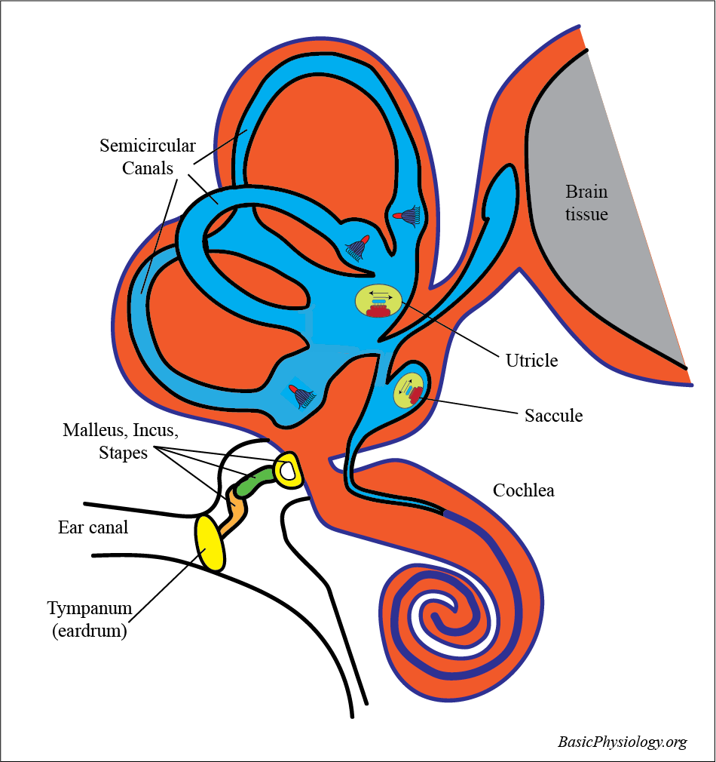
H.3.3.3. Equilibrium
A. Introduction :
1. The vestibular system can be divided into two parts:
  a. the parts that detect linear acceleration (utricle and saccule); also called static movements
  b. the parts that detect rotational acceleration (the three semi-circular canals); also called dynamic movements.
2. Just a reminder of the most important structures in the vestibuli, adjacent to the outer ear, the middle ear and the cochlea.
Note the location of two structures at the base of the semi-circular canals; the utricle and the saccule, and that of the crista-ampullaris in the three semi-circular canals
www.BasicPhysiology.org H.3.3.3. Equilibrium slide #1

Slide 2
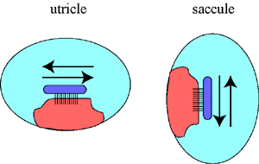
H.3.3.3. Equilibrium
B. The Utricle and the Saccule:
1. The utricle and the saccule are fluid-filled spaces. They contain a macula which is oriented in the horizontal direction (= utricle) or in the vertical direction (= saccule). These two organs therefore detect movements in the horizontal and in the vertical direction.
www.BasicPhysiology.org H.3.3.3. Equilibrium slide #2

Slide 3
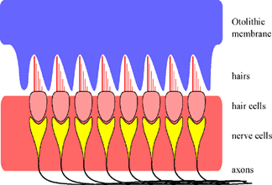
H.3.3.3. Equilibrium
B. The Utricle and the Saccule:
2. The Macula:
The macula is the sensor in these two organs. It essentially consists of a row of hair cells. The hairs are connected to a gelatinous mass called the otholithic membrane. The other side of the hair cell is connected to a nerve. This is the beginning of the vestibular nerve.
www.BasicPhysiology.org H.3.3.3. Equilibrium slide #3

Slide 4
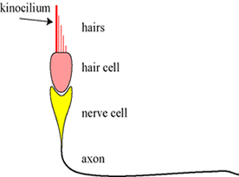
H.3.3.3. Equilibrium
B. The Utricle and the Saccule:
The Hair Cell:
In contrast to the hair cells in the cochlea, there is also an orientation in the configuration of the hairs in the macula. One of the hairs is longer and thicker than the others. This special hair is called a kinocilium (plural kinocilia) and is, as it were, a point of reference for these hairs.
www.BasicPhysiology.org H.3.3.3. Equilibrium slide #4

Slide 5
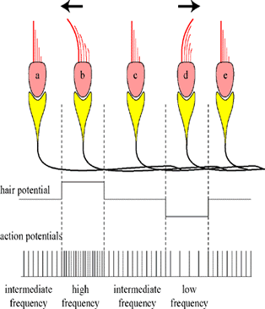
H.3.3.3. Equilibrium
B. The Utricle and the Saccule:
4. How does it work?
When the head starts to move in one direction, the otolithic membrane will move in the opposite direction. This is due to the inertia of the otolith. Because the hair cells move in one direction and the otolithic membrane in the other, all the hairs will bend. As we have seen before in the organ of Corti, this will influence stretch channels in the neighbourhood to open, thereby depolarizing the membrane and generating action potentials.
www.BasicPhysiology.org H.3.3.3. Equilibrium slide #5

Slide 6
H.3.3.3. Equilibrium
B. The Utricle and the Saccule:
5. Forward and backward or up-and-down?
But in the saccule and the utricle, there is an additional problem. These two organs must also detect whether the horizontal movement is forward or backward (or in the case of a saccule; vertical movement, up or down). As shown in the diagram, this is solved in the following manner. If the hairs bend towards the kinocilium, then there will be a depolarization in the hair cell. If the hairs bend the other way, away from the kinocilium, then the hair cell will hyperpolarize.
www.BasicPhysiology.org H.3.3.3. Equilibrium slide #6

Slide 7
H.3.3.3. Equilibrium
B. The Utricle and the Saccule:
6. Frequency modulation:
The final step is to transduce (=translate) the depolarization into action potentials. As in the organ of Corti, depolarization causes more action potentials and the frequency becomes higher. This is because the polarity moves closer to the threshold. The opposite happens when the polarity moves away from the threshold. Then, during hyperpolarization, there will be less action potentials; the frequency is lower. This transduction from amplitude to frequency is (technically) called "frequency modulation" (like in the radio! FM vs. AM).
www.BasicPhysiology.org H.3.3.3. Equilibrium slide #7

Slide 8
H.3.3.3. Equilibrium
B. The Utricle and the Saccule:
7. Acceleration versus velocity.
It is important to realize that it is the acceleration that stimulates the otolithic membrane to shift, thereby bending the hairs, not the velocity itself. If it had been the velocity that shifted the otoliths, then we would never be able to drive in a car or fly in a plane. No, it is the change in velocity (=acceleration or deceleration) that shifts the otoliths and that is what we feel.
www.BasicPhysiology.org H.3.3.3. Equilibrium slide #8

Slide 9
H.3.3.3. Equilibrium
B. The Utricle and the Saccule:
8. Frequency modulation.
Note that when the utricle or the saccule are in rest, that then the hair cells still generate action potentials. In other words, it is actually telling the brain that it is working and that there is at the moment no acceleration or deceleration. But if the frequency increases or decreases, then it can report how much (the change in frequency) and in which direction (accelerating or decelerating).
www.BasicPhysiology.org H.3.3.3. Equilibrium slide #9

Slide 10
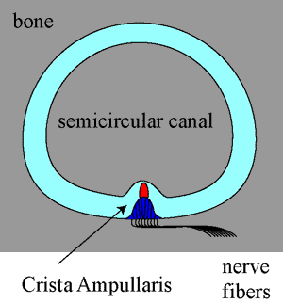
H.3.3.3. Equilibrium
C. The Semi-Circular Canals:
1. The semi-circular canal:
This is a canal that is filled with endolymph. The canal is circular which means that the fluid can move in a circle. At one end of the canal, there is the crista ampullaris that detects the movements of the fluid and pass on that information to the vestibular nerve.
www.BasicPhysiology.org H.3.3.3. Equilibrium slide #10

Slide 11
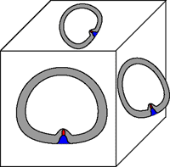
H.3.3.3. Equilibrium
C. The Semi-Circular Canals:
2. The orientation of the three semi circular canals.
The three canals are oriented in three different directions and at right angles to each other. Like the three faces of a cube: one is at the front plane, one at the side plane and the third at the top plane. In this way, rotation at any angle can be picked up by one or two canals.
www.BasicPhysiology.org H.3.3.3. Equilibrium slide #11

Slide 12
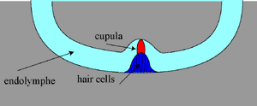
H.3.3.3. Equilibrium
C. The Semi-Circular Canals:
The Crista Ampullaris
As in the macula, there are hair cells in the bottom of the canal. The hairs are fixed to a "cupula" (= sort of a hat) which is a gelatinous mass. This cupula can turn left or right, depending on the flow of the endolymph.
www.BasicPhysiology.org H.3.3.3. Equilibrium slide #12

Slide 13
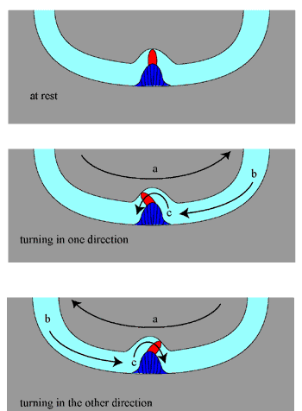
H.3.3.3. Equilibrium
C. The Semi-Circular Canals:
4. How does it work?
When the head starts to rotate, the bone (=skull), and therefore the canal will also start rotating. But the endolymphe, due to its inertia, will not move immediately. So, if the head rotates in direction (a), then the fluid, which lags behind, will flow in the opposite direction (b). This fluid flow will push the cupula to bend to the left (c). If the head rotates in the opposite direction, then of course, the fluid will also flow in the opposite direction and the cupula will bend to the right.
www.BasicPhysiology.org H.3.3.3. Equilibrium slide #13

Slide 14
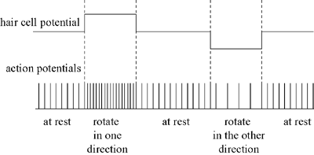
H.3.3.3. Equilibrium
C. The Semi-Circular Canals:
5. Frequency Modulation
As in the saccule and utricle, it is crucial to know whether the head its rotating to the right or to the left. Therefore, in a similar way, there is a system of modulating the intracellular potential to action potential frequency. Thus, rotation in one direction will increase the (resting) frequency whereas rotation in the opposite direction will cause a decrease in the resting frequency.
www.BasicPhysiology.org H.3.3.3. Equilibrium slide #14

Slide 15
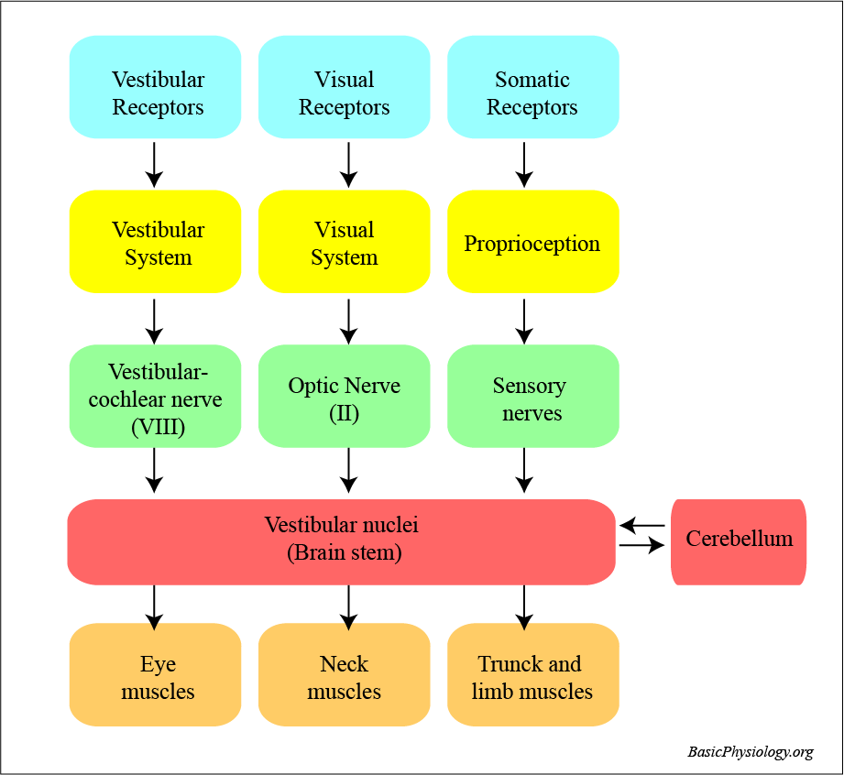
H.3.3.3. Equilibrium
D. Integration of the Vestibular system with other systems in the body:
1. Three systems are involved in our balance:
a. the vestibular system
b. the visual system
c. the musculo-skeletal system
www.BasicPhysiology.org H.3.3.3. Equilibrium slide #15

Slide 16
H.3.3.3. Equilibrium
D. Integration of the Vestibular system with other systems in the body:
2. Proprioception:
This is the system that informs the brain of our "position" in space. Sensors are located in the joints (to measure the angle), in the skeletal muscles (to measure their length) and especially in the neck (to determine the relation of the head to the rest of the body).
www.BasicPhysiology.org H.3.3.3. Equilibrium slide #16

Slide 17
H.3.3.3. Equilibrium
D. Integration of the Vestibular system with other systems in the body:
Vestibular nuclei:
All this information is fed into the vestibular nuclei for processing. In addition, there is a close relation between these nuclei and the cerebellum (=auto pilot).
www.BasicPhysiology.org H.3.3.3. Equilibrium slide #17

Slide 18
H.3.3.3. Equilibrium
D. Integration of the Vestibular system with other systems in the body:
4. Effectors:
From the vestibular nuclei, commands are given to the eye muscles, the trunk, the limb and the neck muscles to either keep the shape of the body or to change it according to demand. The role of the neck is very visible in animals with long necks such as horses and camels. The animal can rotate its neck to look, for example, behind itself. When the animal then wants to move in that direction, then the body, as it where, "follows" the neck.
.
www.BasicPhysiology.org H.3.3.3. Equilibrium slide #18

Slide 19
H.3.3.3. Equilibrium
D. Integration of the Vestibular system with other systems in the body:
5. When are we in balance?
We are in balance when the information from the three systems agree with each other. For example, suppose that you are in an elevator which looks outside (as in some expensive hotels) and you go up in that elevator. Then your eyes tell you that you are going up, your sacule feels that you are going up and the pressure sensors in your musculo-skeletal system informs the brain that the body is moving upwards.
www.BasicPhysiology.org H.3.3.3. Equilibrium slide #19

Slide 20
H.3.3.3. Equilibrium
D. Integration of the Vestibular system with other systems in the body:
6. Motion sickness
But if there is a conflict between the information received from one (or two) of the three systems, then we become violently sick: motion sickness. This is well known when one is on a boat in a choppy sea.
www.BasicPhysiology.org H.3.3.3. Equilibrium slide #20

Slide 21
H.3.3.3. Equilibrium
D. Integration of the Vestibular system with other systems in the body:
6. Motion sickness
Another current example is trying to read a book while riding in a car. Your eyes concentrate on the reading (stable) while your vestibular system and your proprioception inform you that you are constantly accelerating and decelerating. Good reason to become very very sick.
www.BasicPhysiology.org H.3.3.3. Equilibrium slide #21

Slide 22
H.3.3.3. Equilibrium
D. Integration of the Vestibular system with other systems in the body:
7. Symptoms:
The symptoms of motion sickness are quite severe:
    nausea
    vomiting
    pallor
    rapid breathing
    sweating
www.BasicPhysiology.org H.3.3.3. Equilibrium slide #22

Slide 23
H.3.3.3. Equilibrium
D. Integration of the Vestibular system with other systems in the body:
8. Why so severe?
Body position is crucial fo survival. The brain needs to know all the time the EXACT position of the head, the limbs etc. It must be able to act immediately in the case of danger. If there is a conflict in the information it is receiving, it can then no longer react adequately to danger. Whatever causes this mis-information must STOP immediately. Hence, motion sickness is really incapacitating.
www.BasicPhysiology.org H.3.3.3. Equilibrium slide #23

Slide 24
H.3.3.3. Equilibrium
This is the end of these
“H.3.3.3. Equilibrium”
slides.
www.BasicPhysiology.org H.3.3.3. Equilibrium slide #24

